Slide 1
Feb 25: Income Level Plots

Slide 2
Literature: Income & Vaccine Hesitancy
In a study looking at low-income, racially, and ethnically diverse parents in the US, most parents (48%) were undecided and hesitant about vaccinating their children against COVID-19 (Schilling et al., 2022)
During this time period, there was steadily changing information regarding COVID vaccines and their safety, specifically for children
Many parents reported waiting for conversations and recommendations from their pediatrician before making the final decision
In a study looking at a nationally representative sample of US adults, low-income participants had 55% lower odds of being vaccinated for COVID-19 (Ben-Umeh & Kim, 2024)
The high-income group was the most likely to have received the COVID-19 vaccine and multiple booster shots
Notes:
https://www.sciencedirect.com/science/article/pii/S0738399122001379?casa_token=p70bPxSKiccAAAAA:g-dLTbiw7TCCciuQ2NuCG2v6Q3aMHaFpc_Uf5WOUcZF_I7yzg5d_0c42TmwdYJ1-4_uQx_SiSA#sec0095
https://pmc.ncbi.nlm.nih.gov/articles/PMC10878507/#abstract1

Slide 3
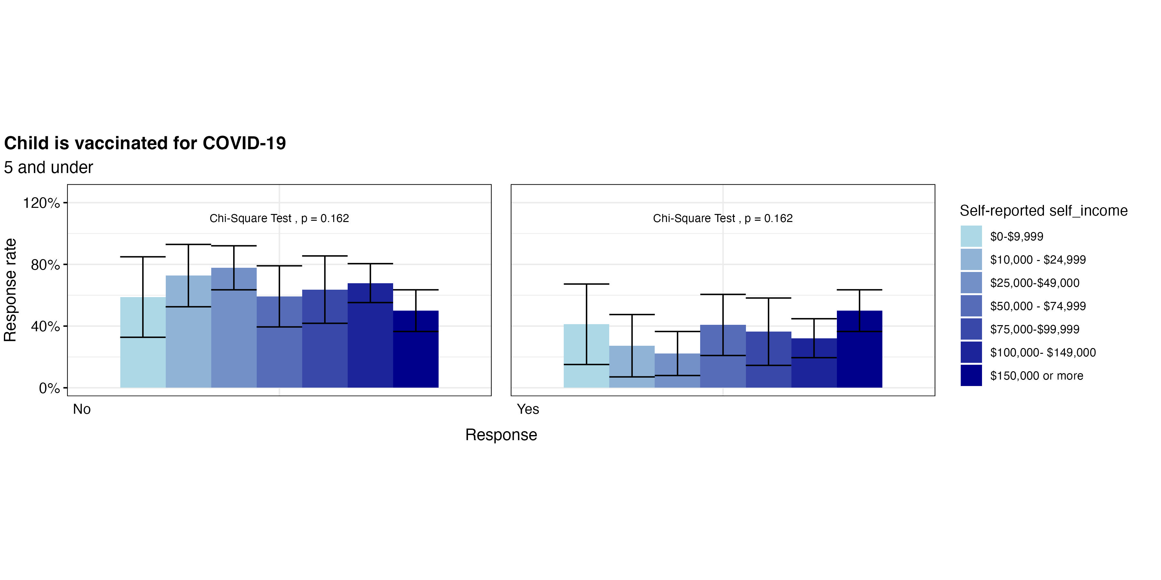
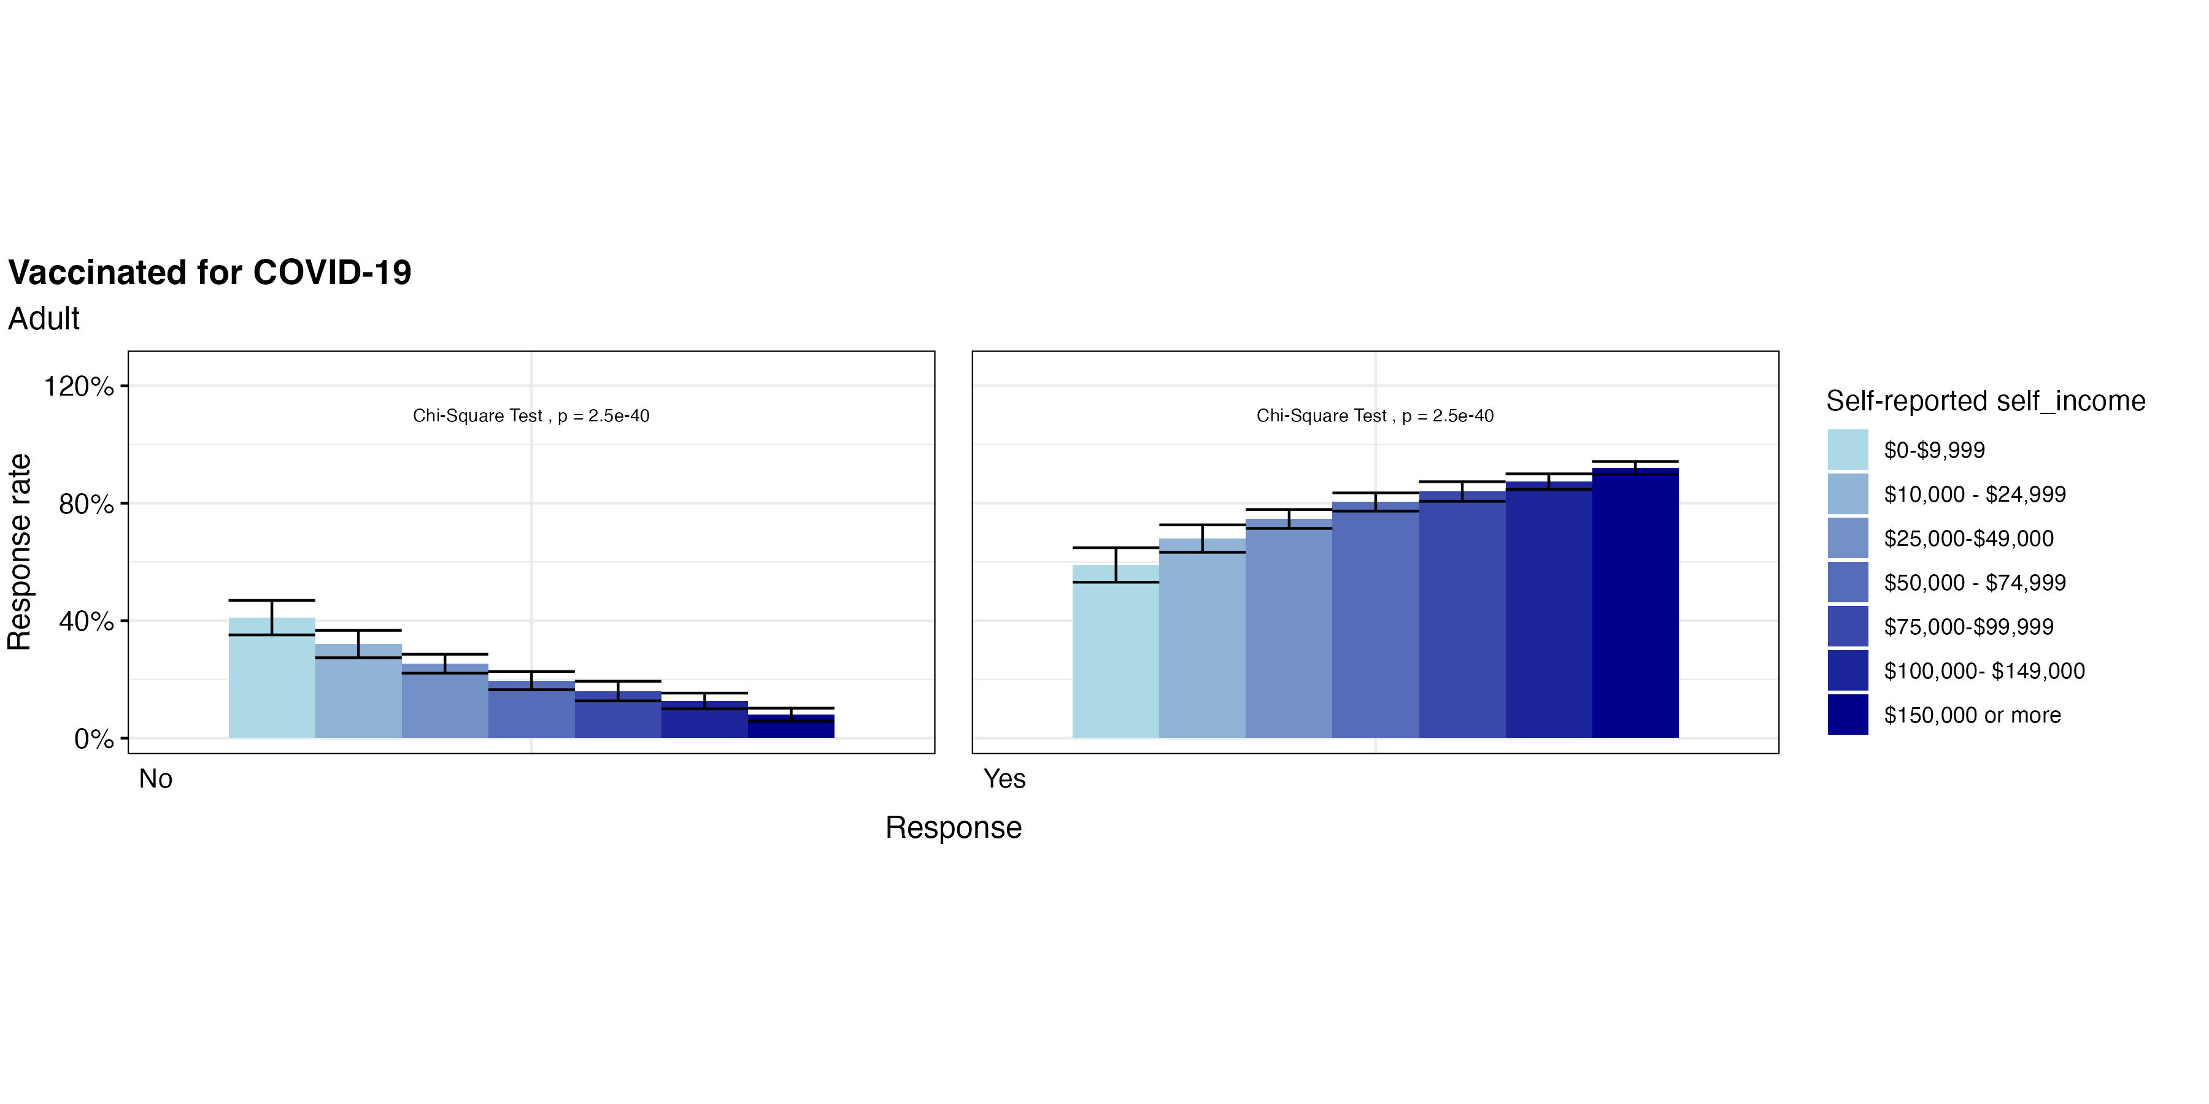
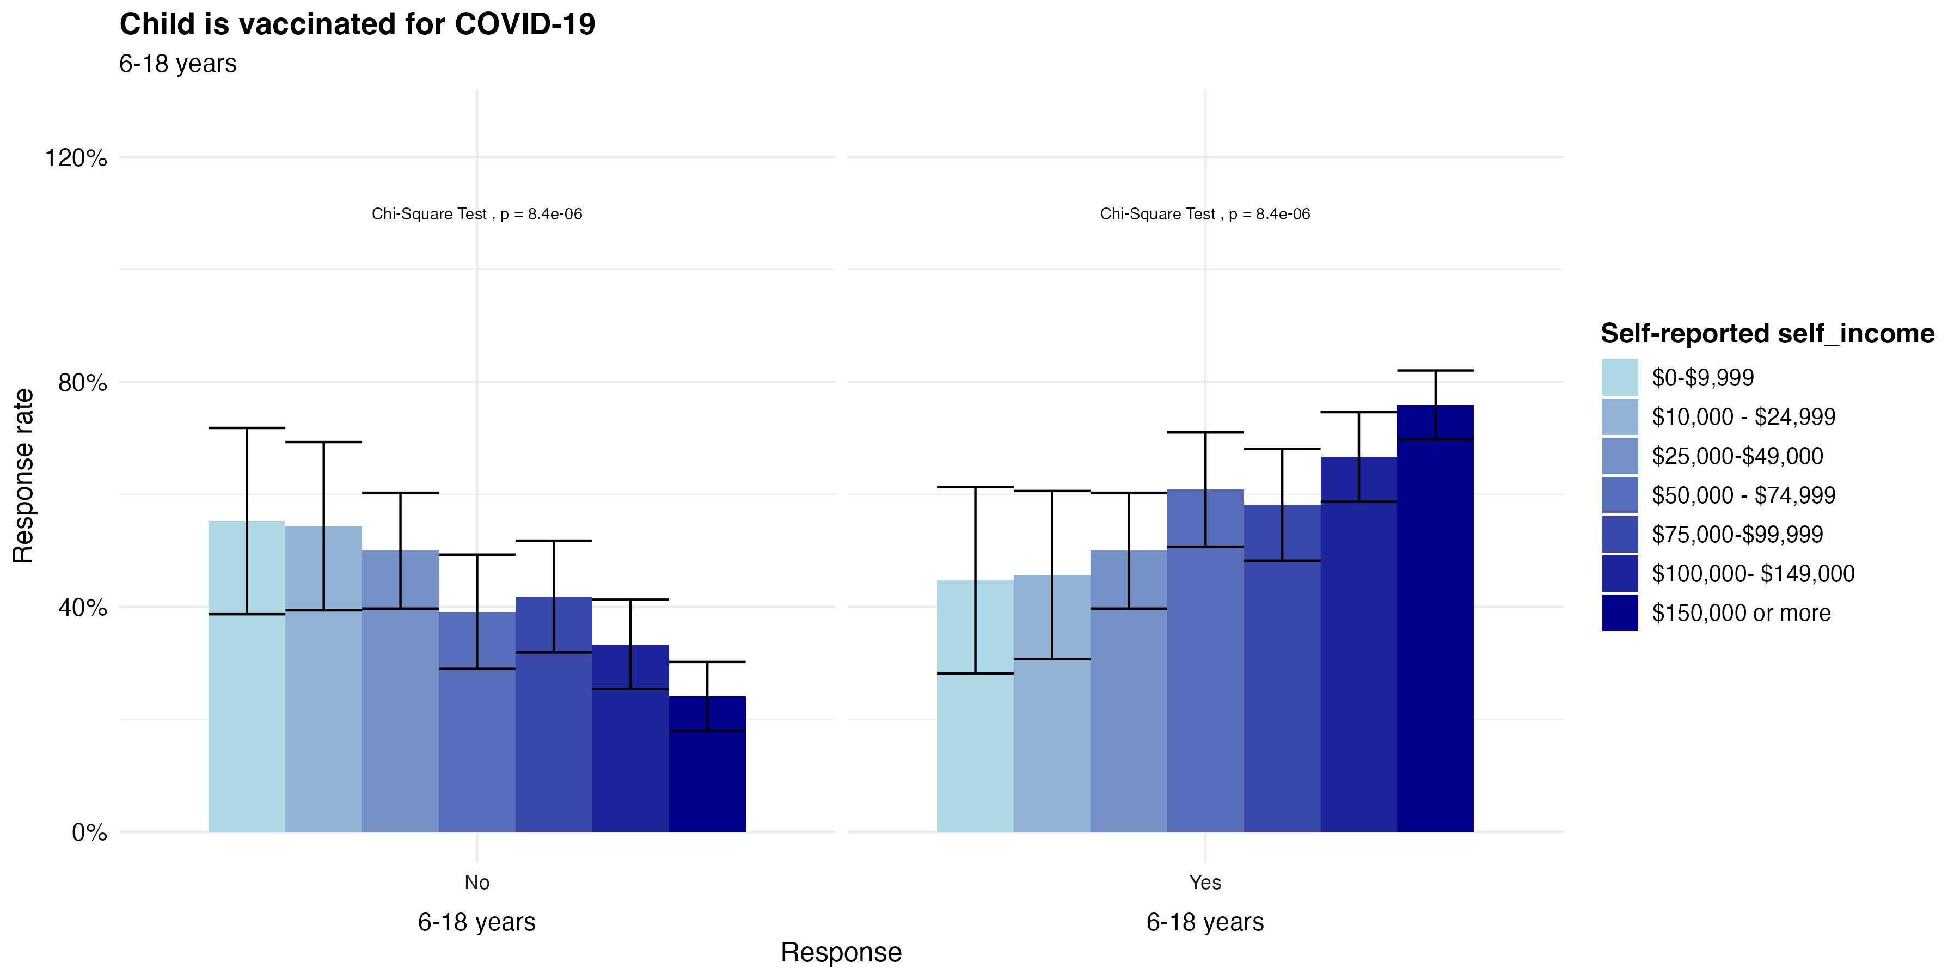
COVID-19 Vaccination Patterns
Among all Yes groups, we see that the highest income bracket has the highest proportion of vaccinated
In adults, it seems that there is a direct relationship between income and vaccination (Proportion for Yes increases with income, Proportion for No decreases with income)
See similar pattern for children 6-18
For children under 5, we see the highest vaccination rates for both low and highest incomes
Although we see that most children under 5 are not vaccinated.

Slide 4
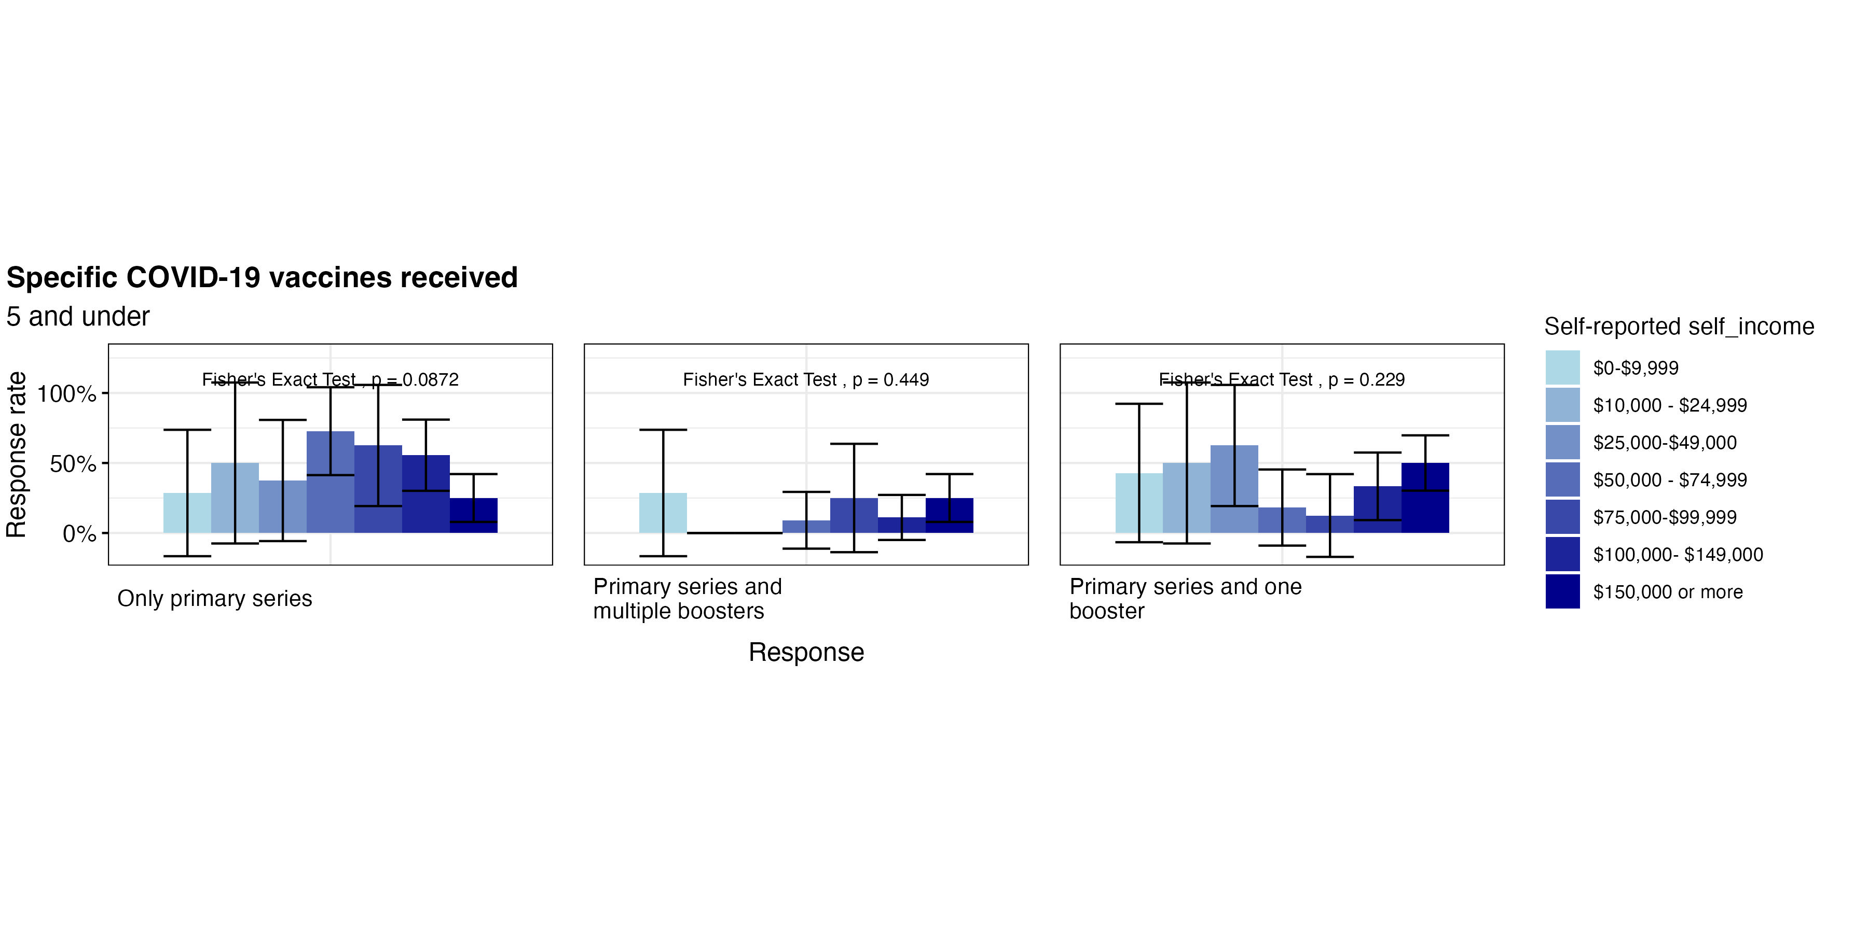
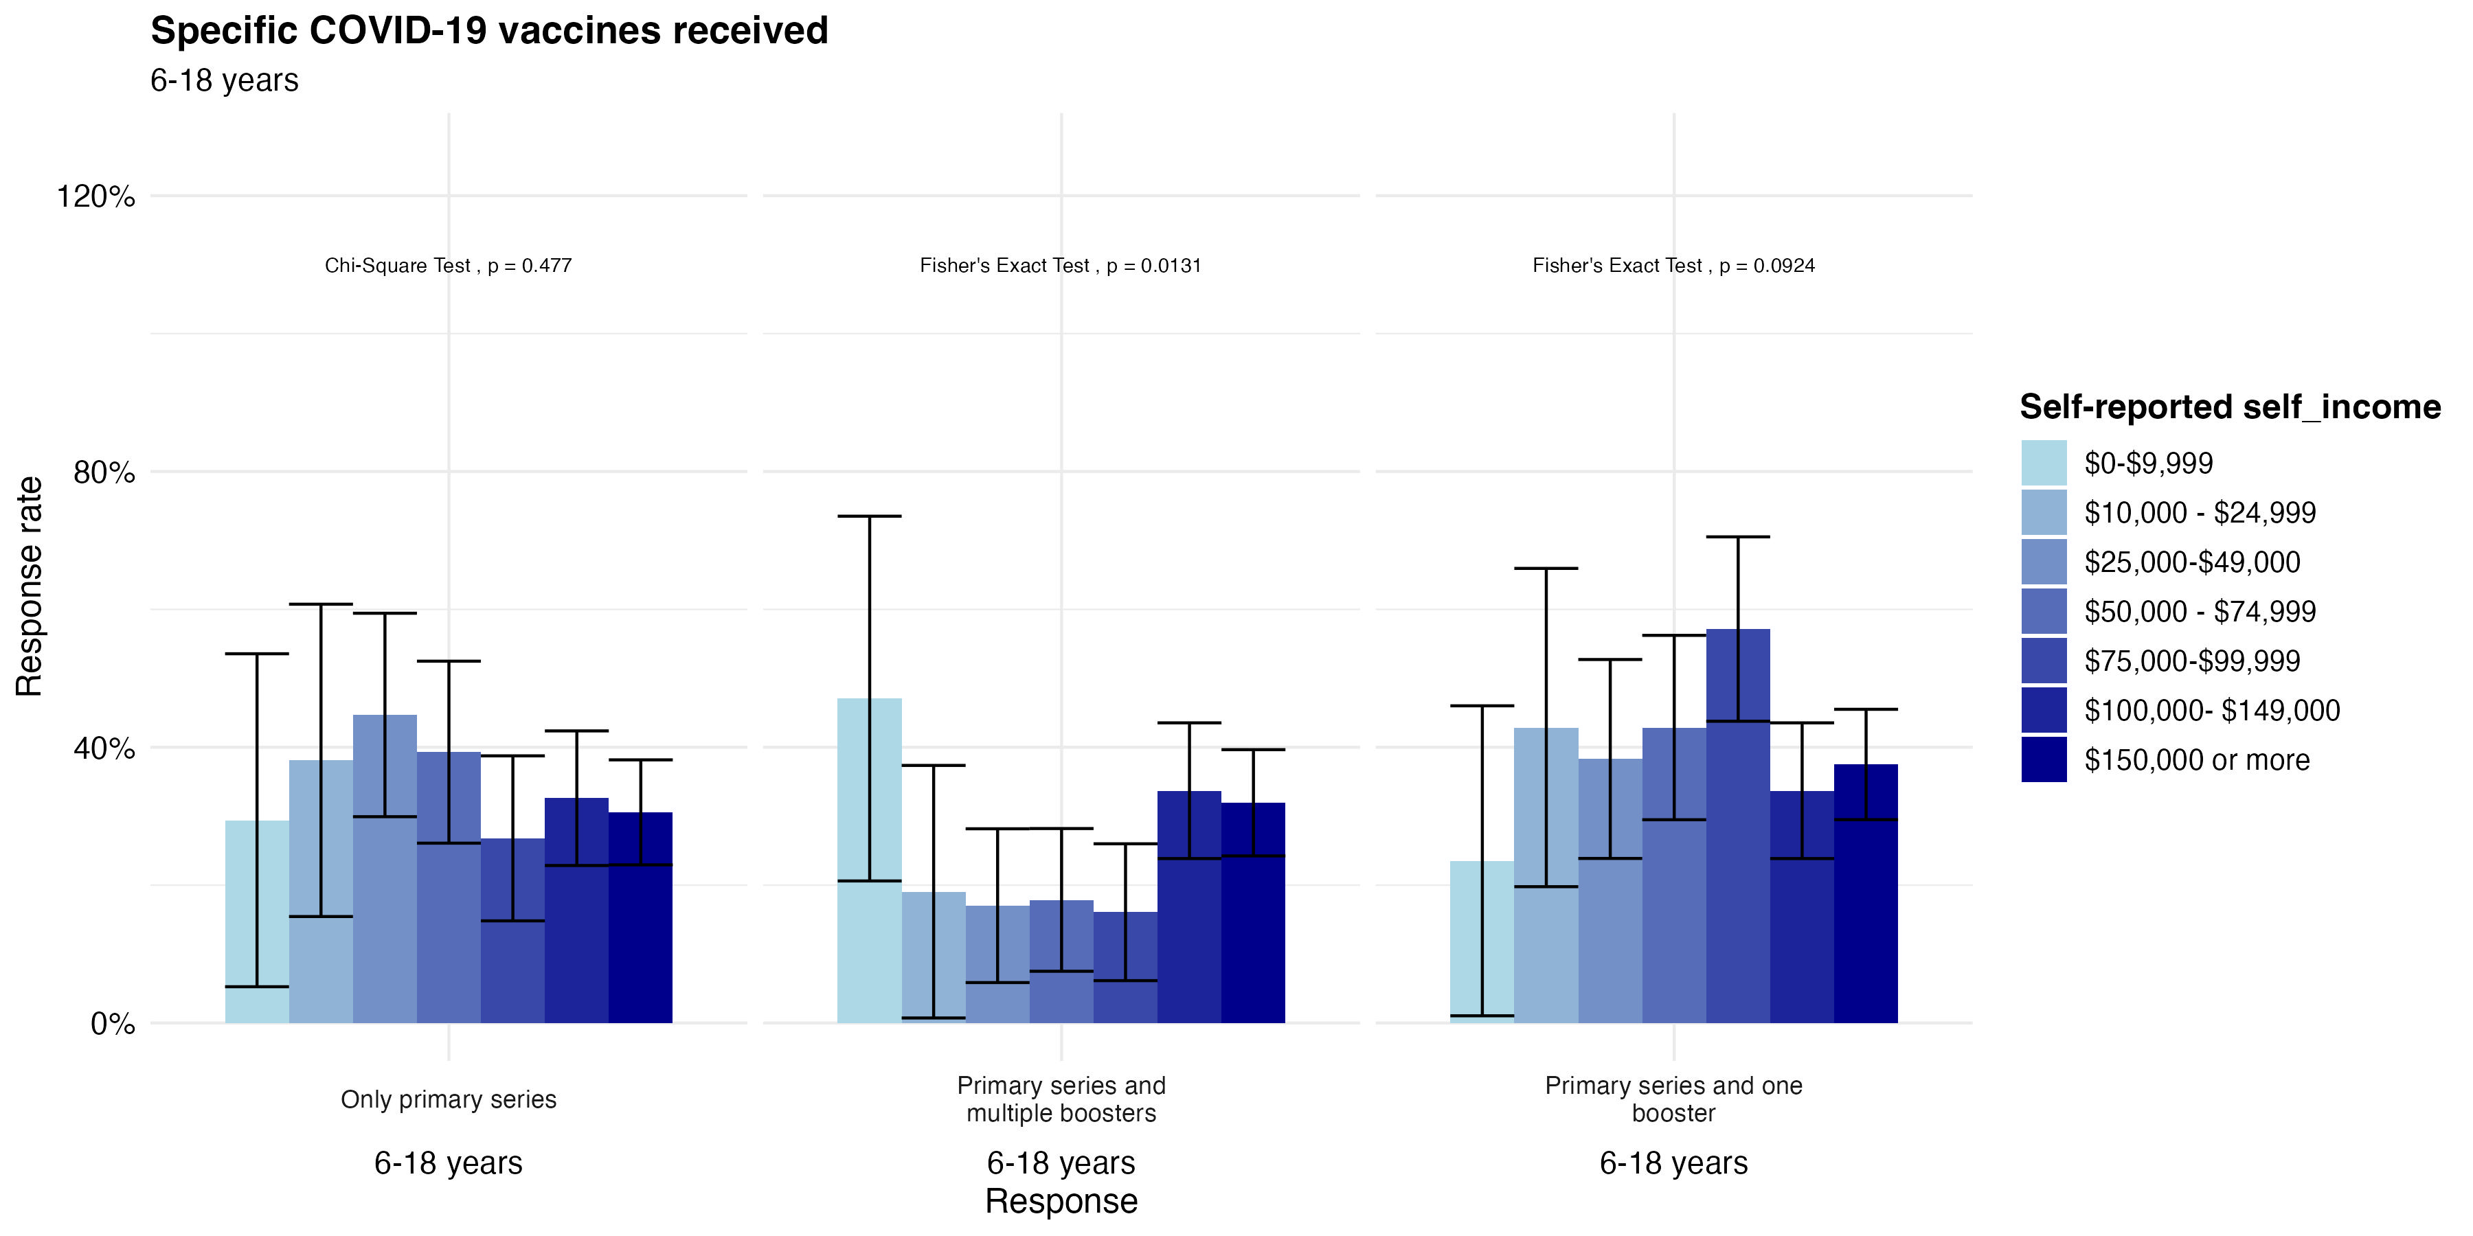
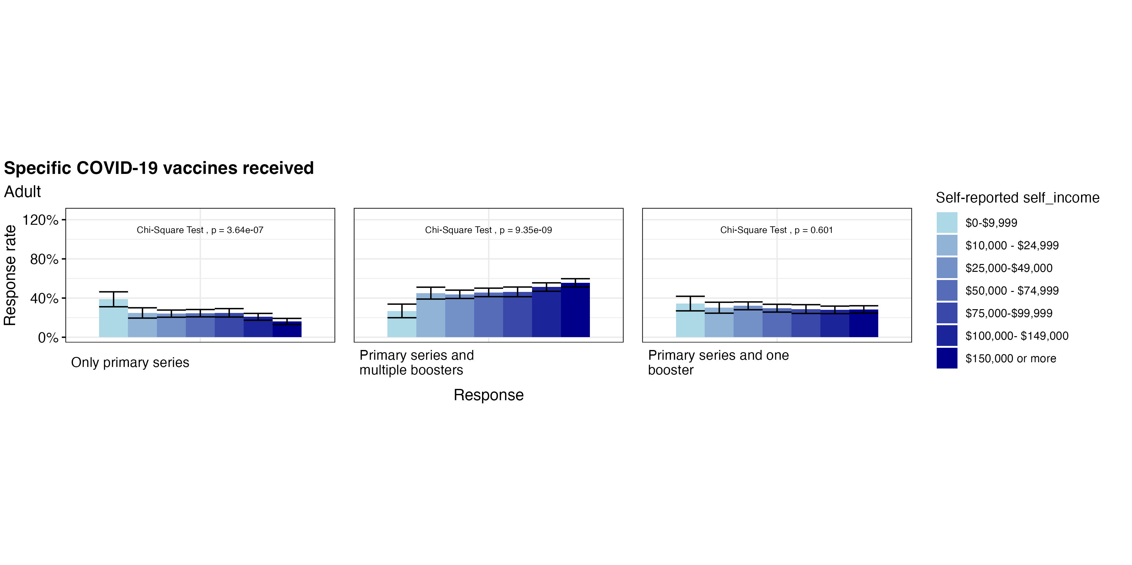
COVID-19 Vaccine Received
Most children under 5 have only the primary vaccine
In the 6-18 age group, low income is the most likely to have multiple boosters
Among adults, lower income is most likely to get only the primary COVID vaccine, while highest income is likely to have multiple boosters

Slide 5
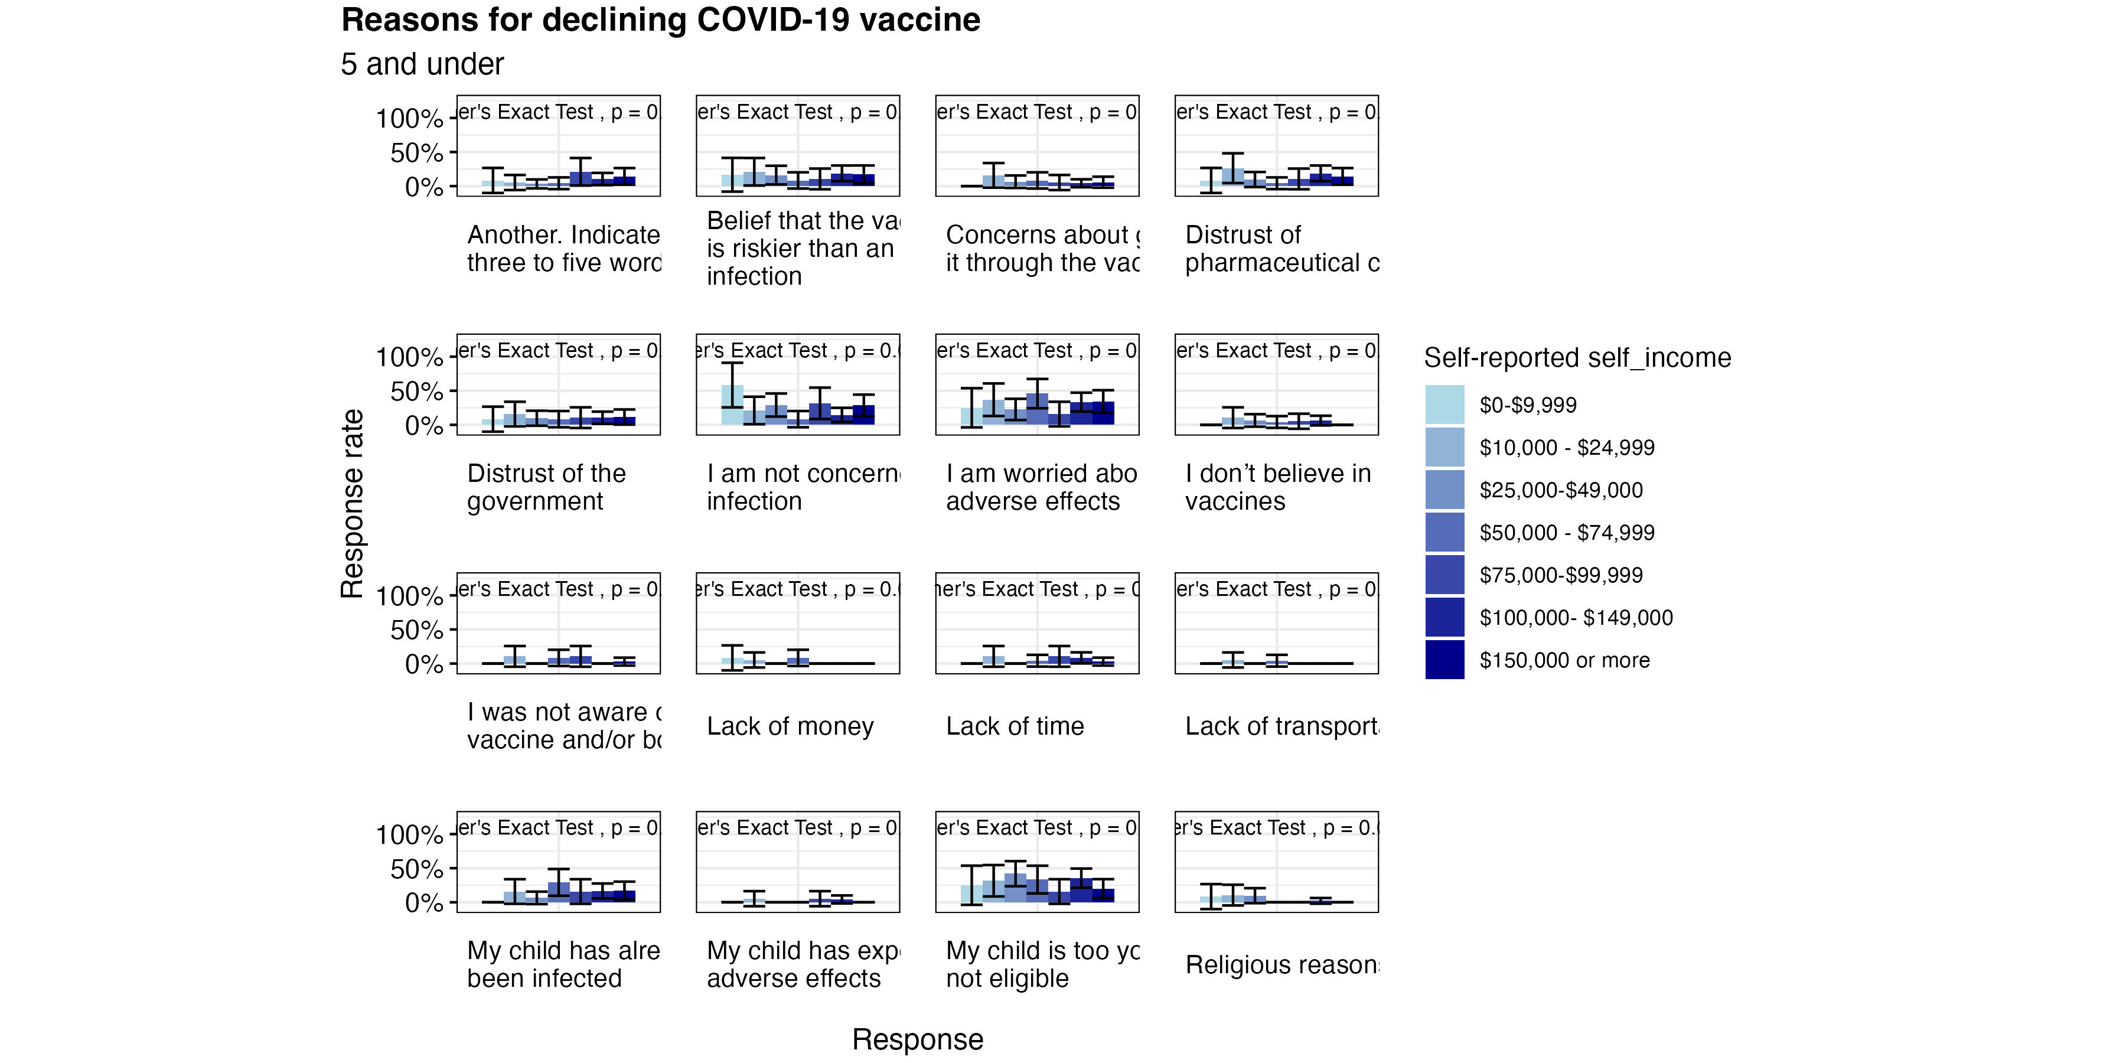
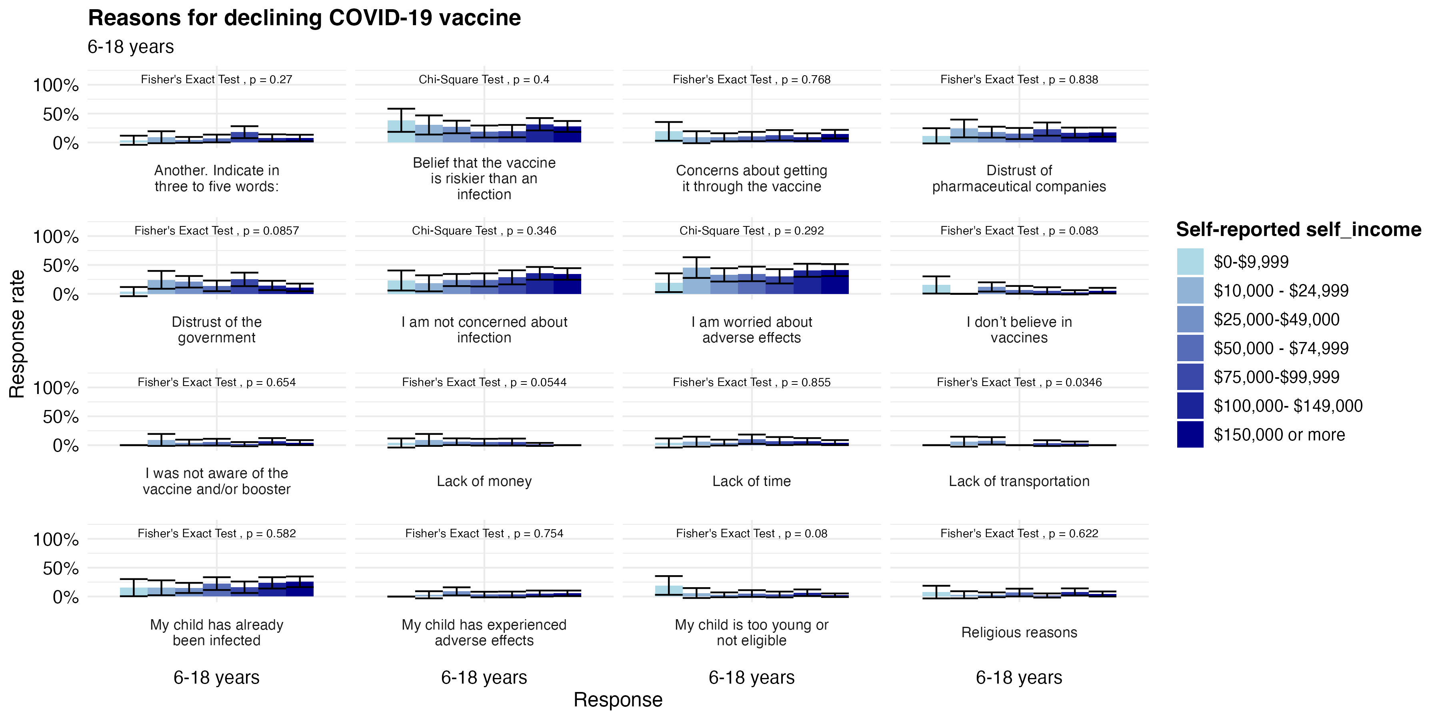
Declining COVID-19 Vaccine among Children
Due to children being ineligible, rather than due to lack of access or anti-vaccine beliefs (especially among middle and higher income)
Many (especially low income) are not concerned about infection
We see a large amount worried about adverse effects of the vaccine among all income levels
Among all income levels, we see a lack of concern about infection

Slide 6
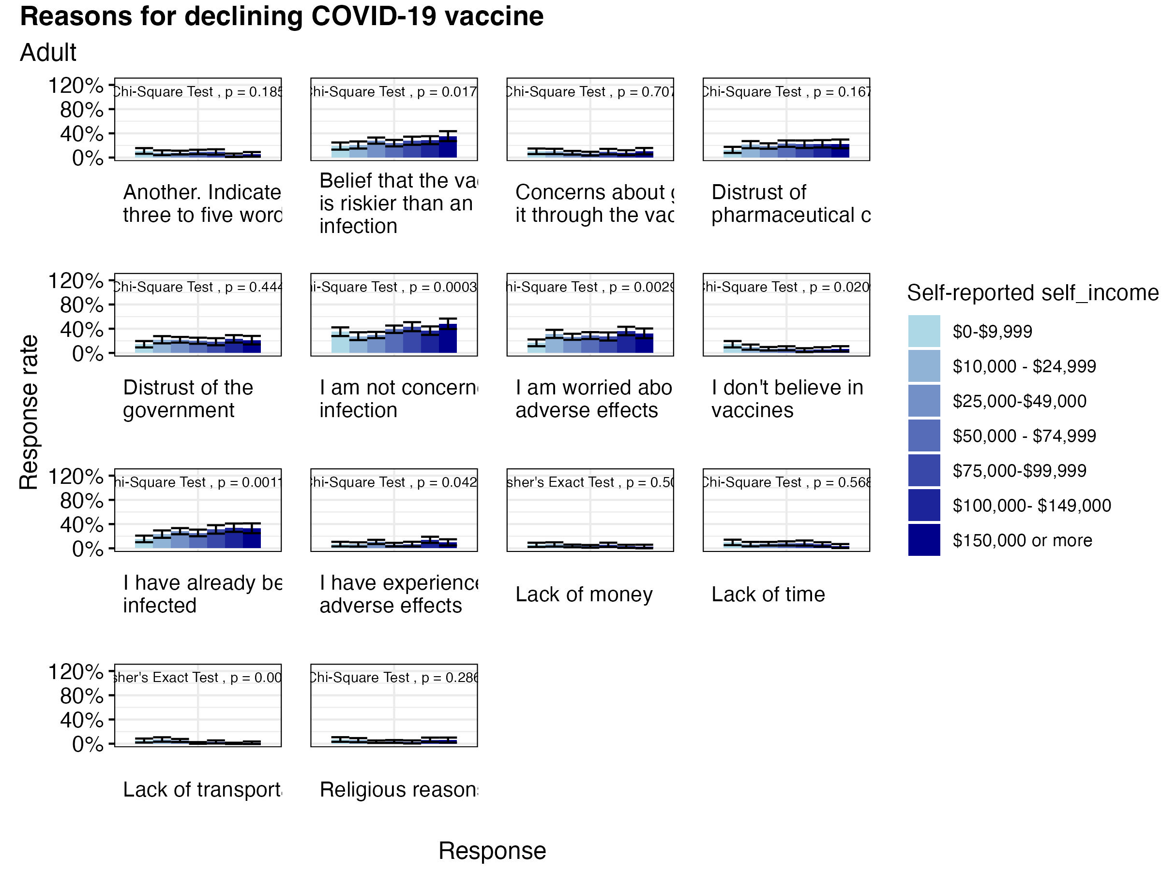
Declining Vaccines Among Adults
Among all income levels, we see beliefs about the danger of the COVID-19 Vaccine as well as a lack of concern about infection
Higher incomes seem to have stronger beliefs about their concern of infection and riskiness of the vaccine

Slide 7
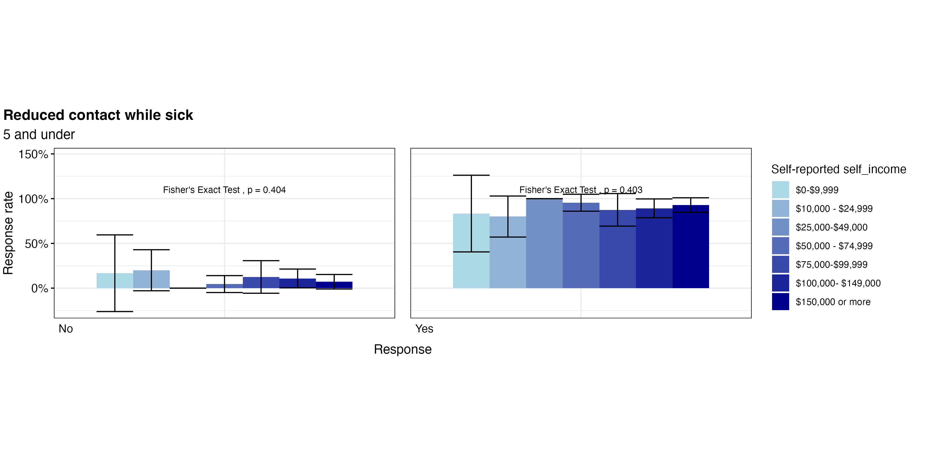
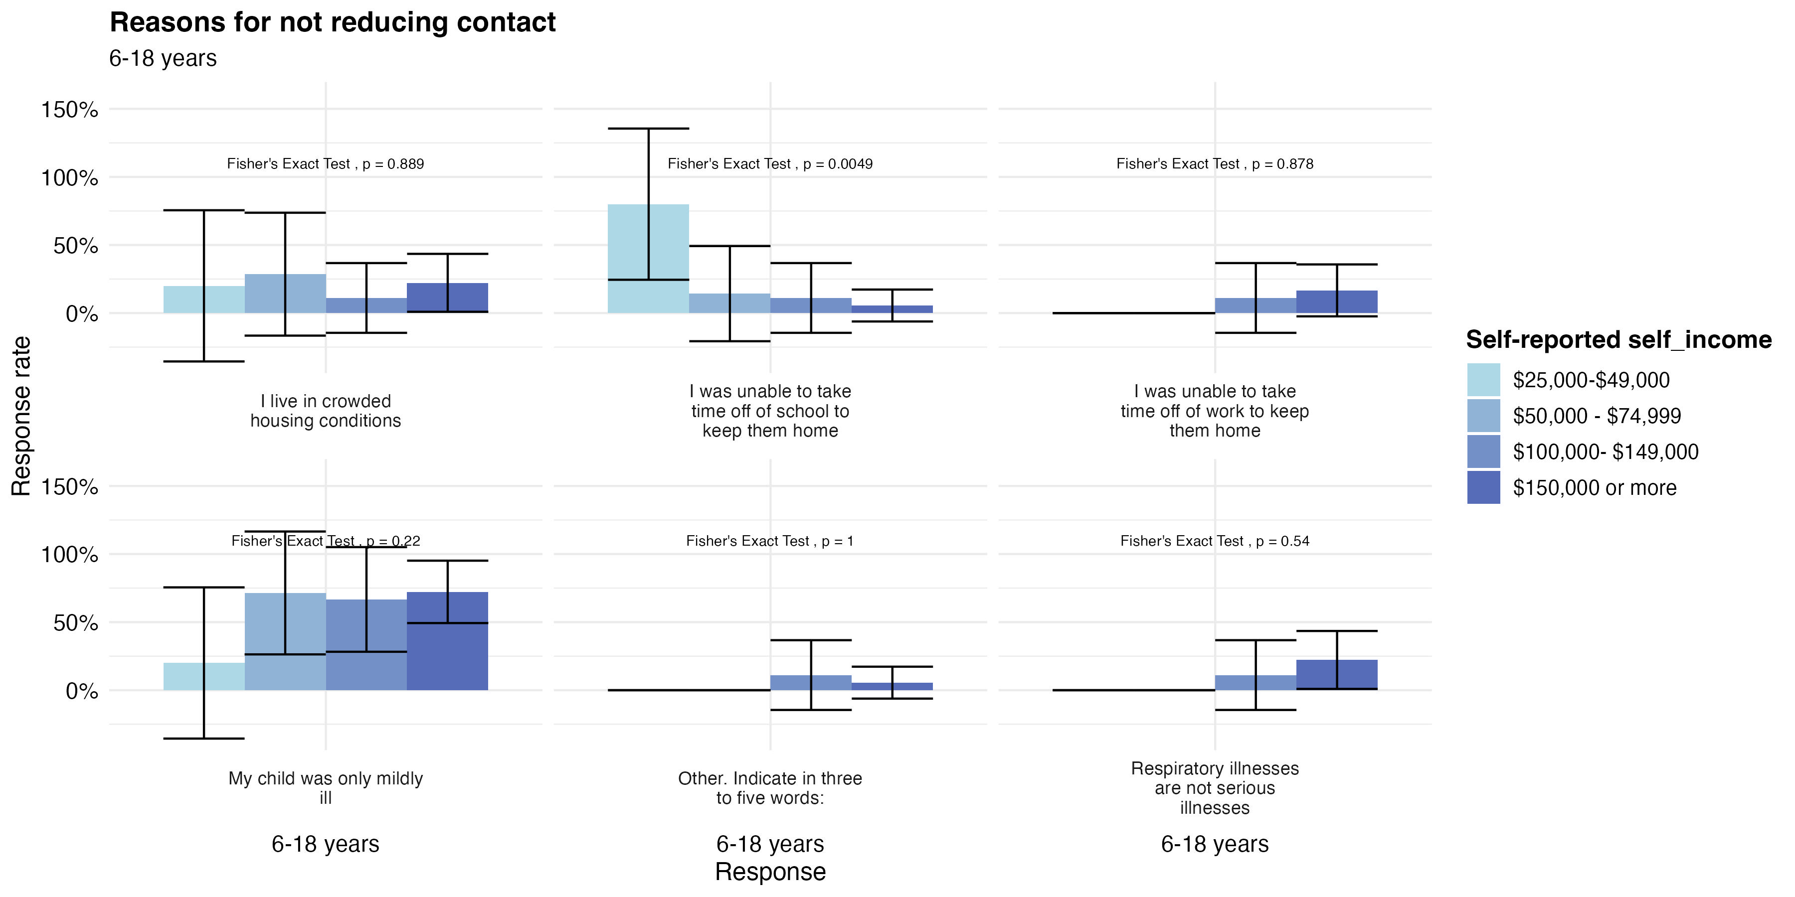
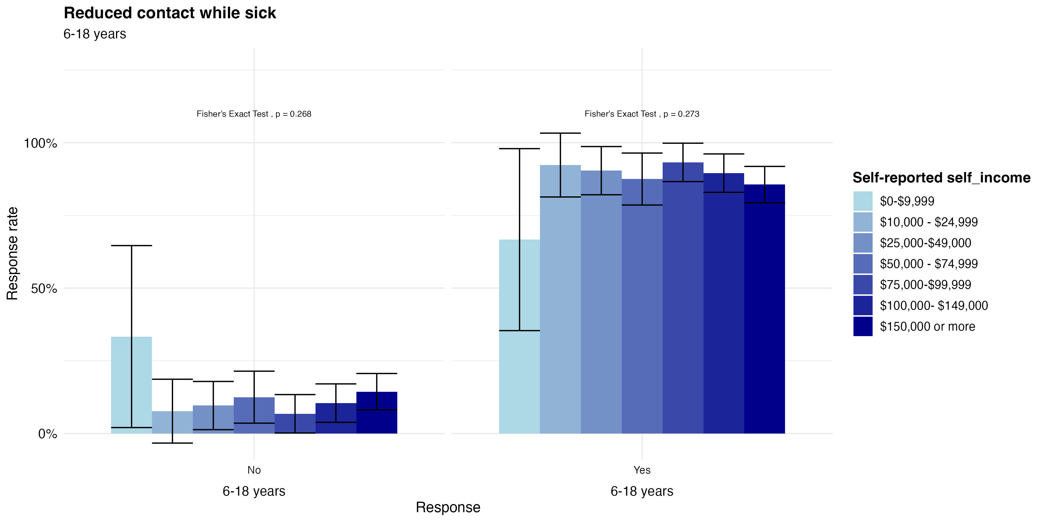
Reducing Contact While Sick
In the case of older children, all income levels except the lowest had very high levels of reduced contact
When looking at reasoning, we see among lower income levels that participants report higher instances of being unable to take time off to keep the children home

Slide 8
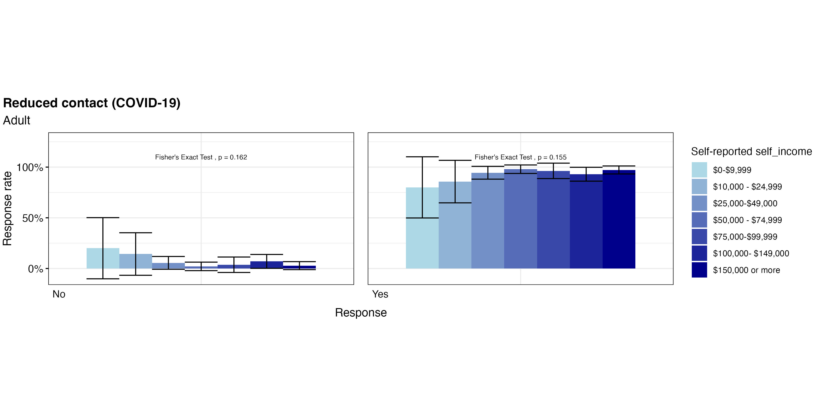
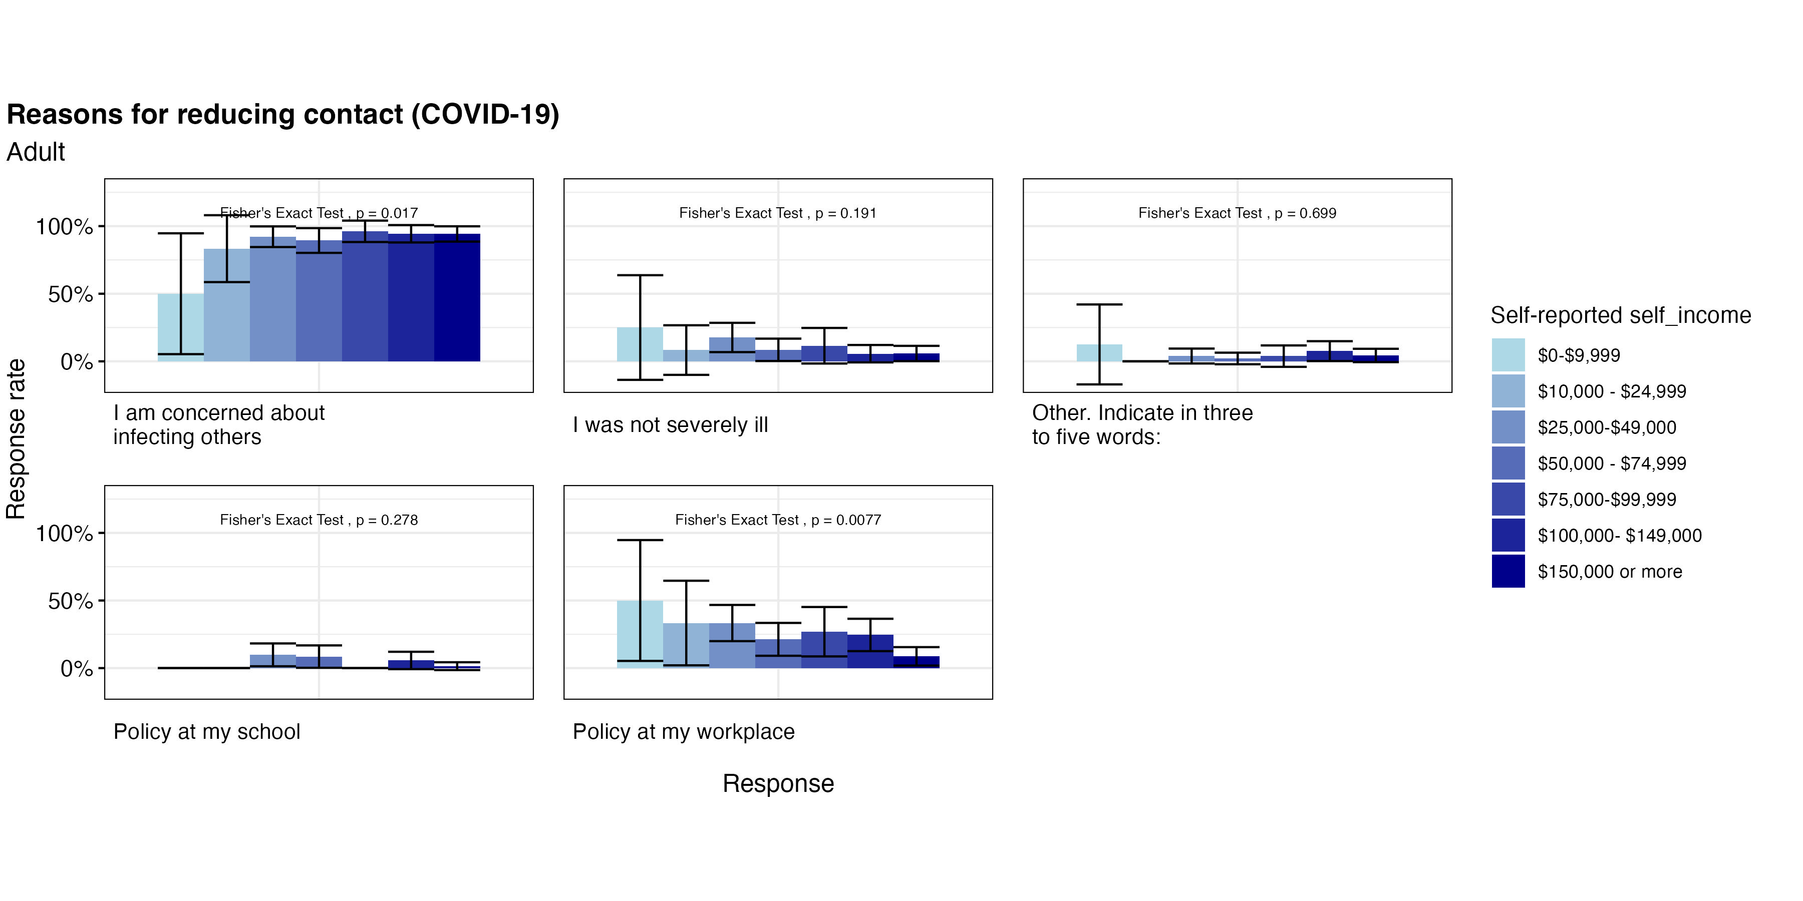
Reduced Contact Among Adults
Adults typically have high rates for reducing contact due to COVID-19
Many who reduce contact (especially at lower income levels) due so due to work policy, rather than concerns or other reasons

Slide 9
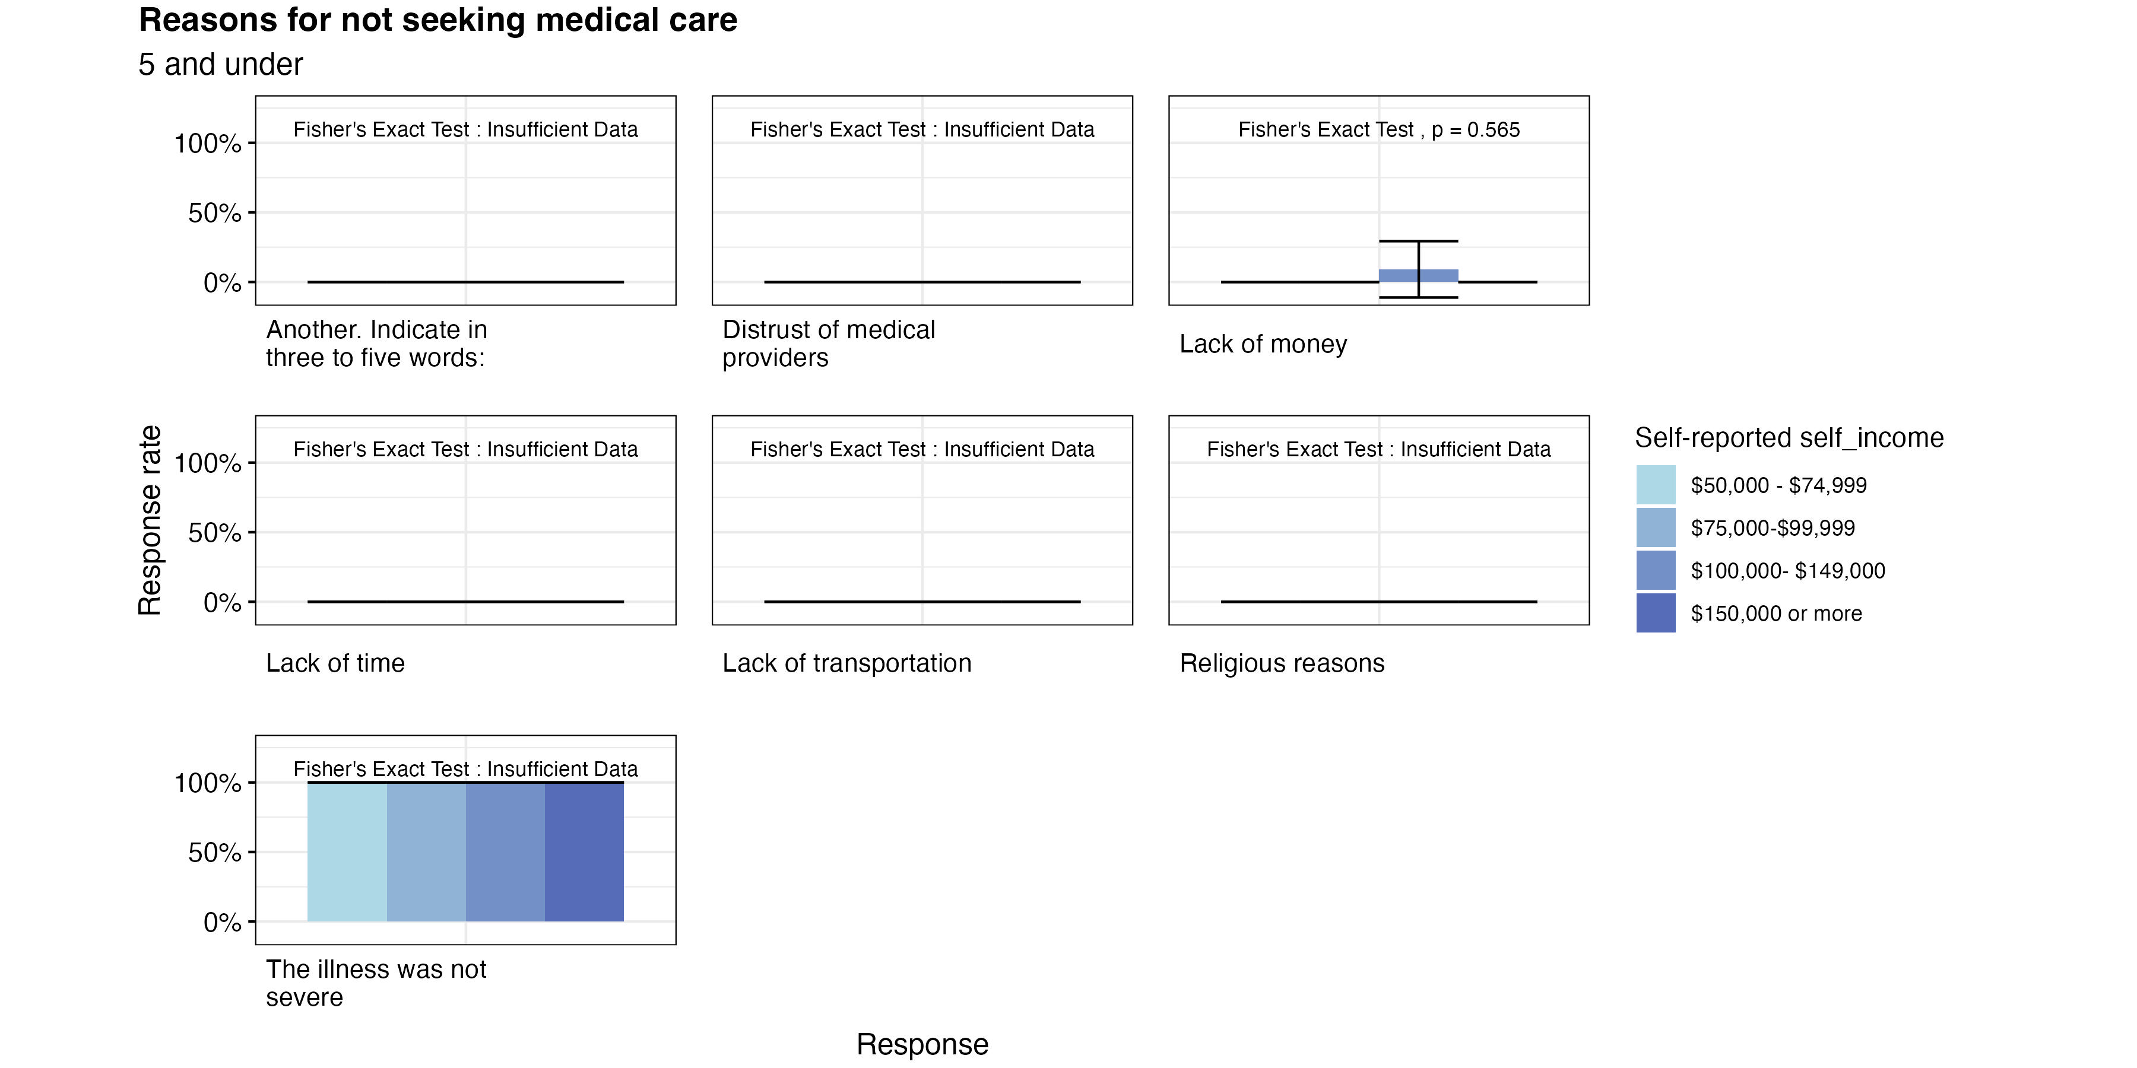
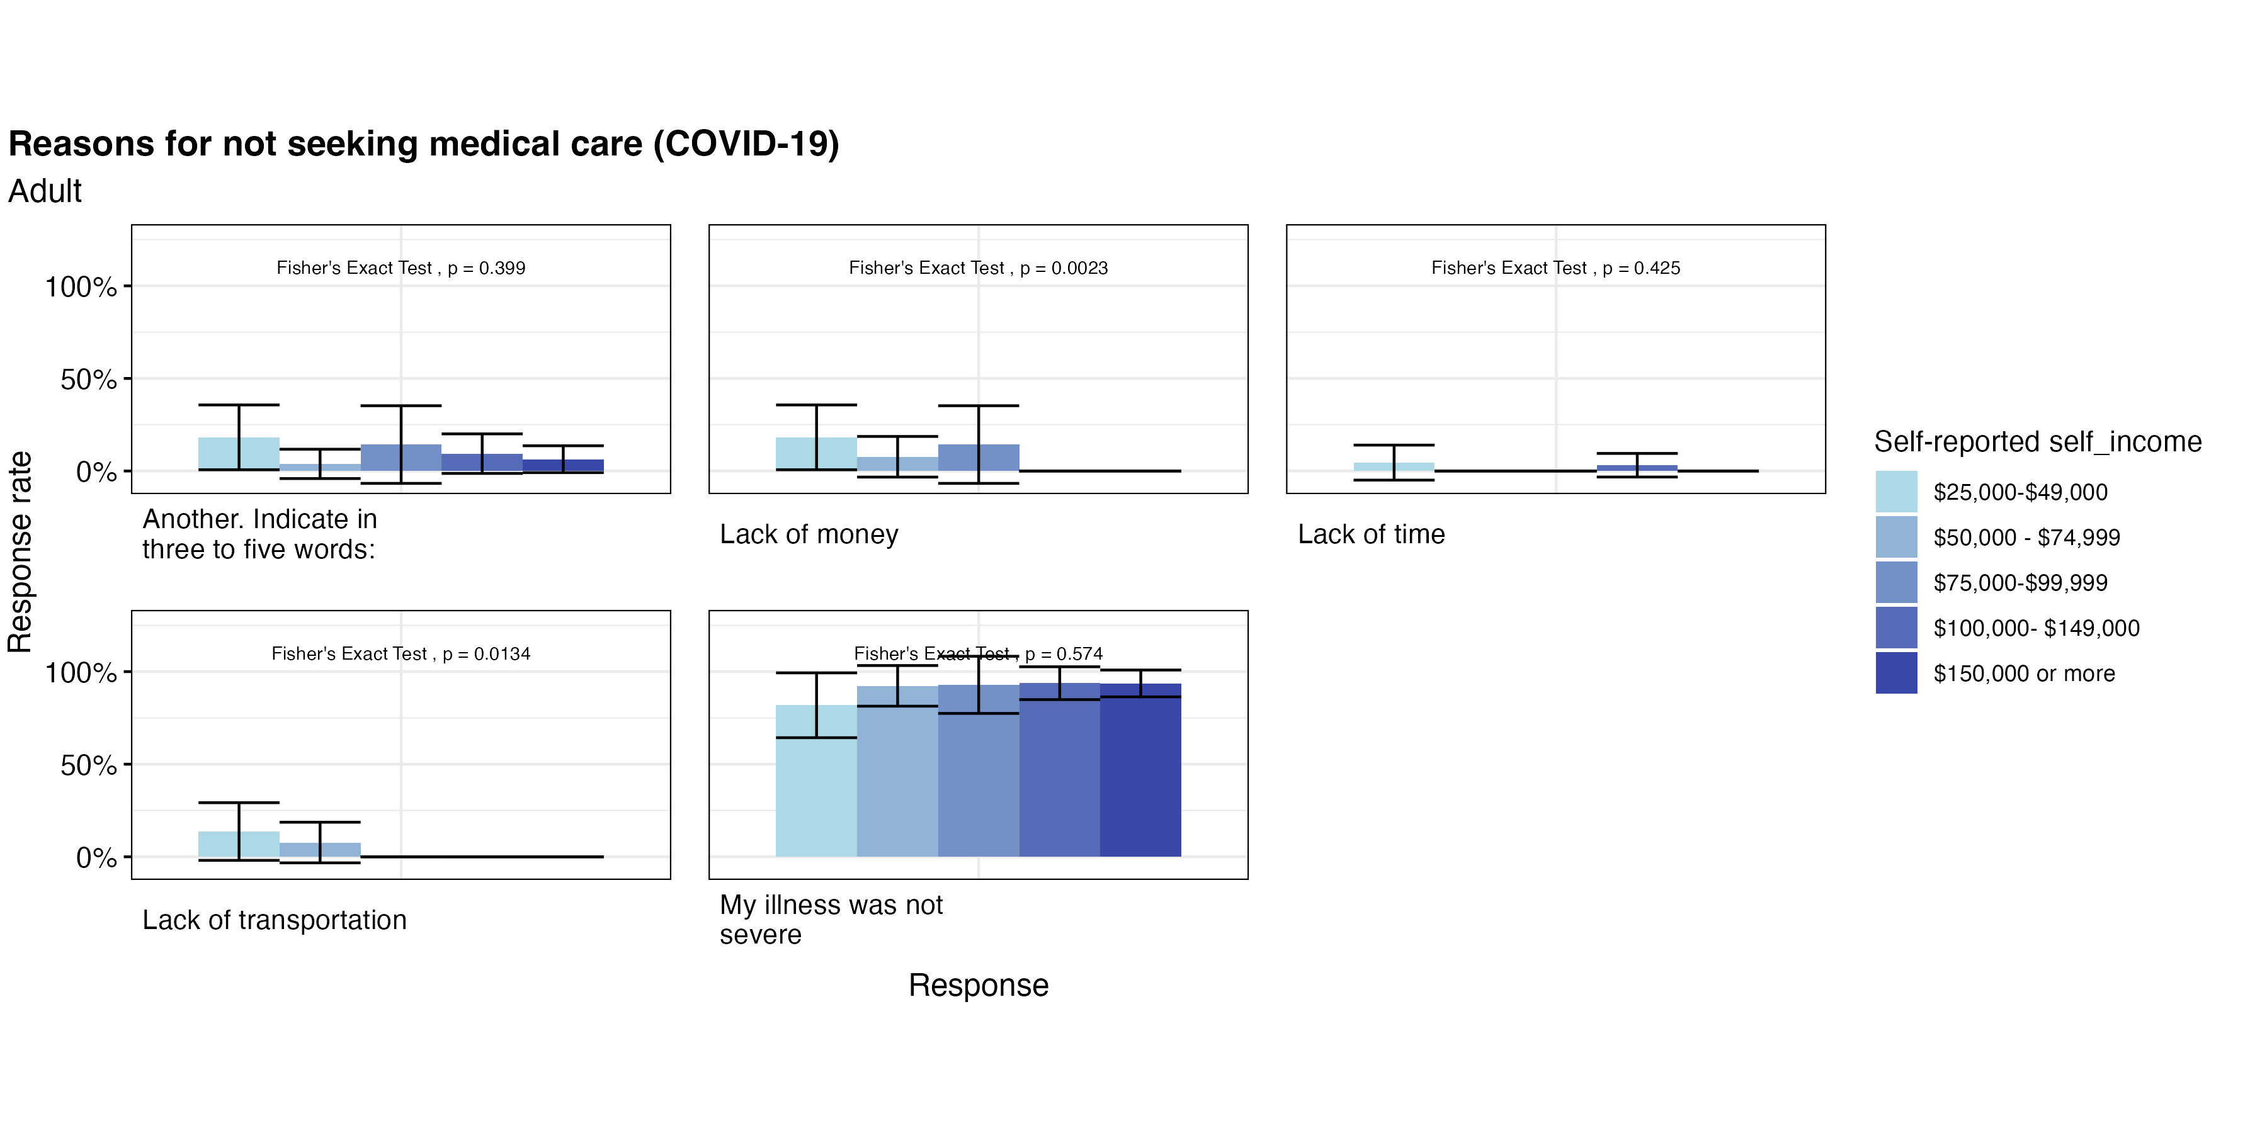
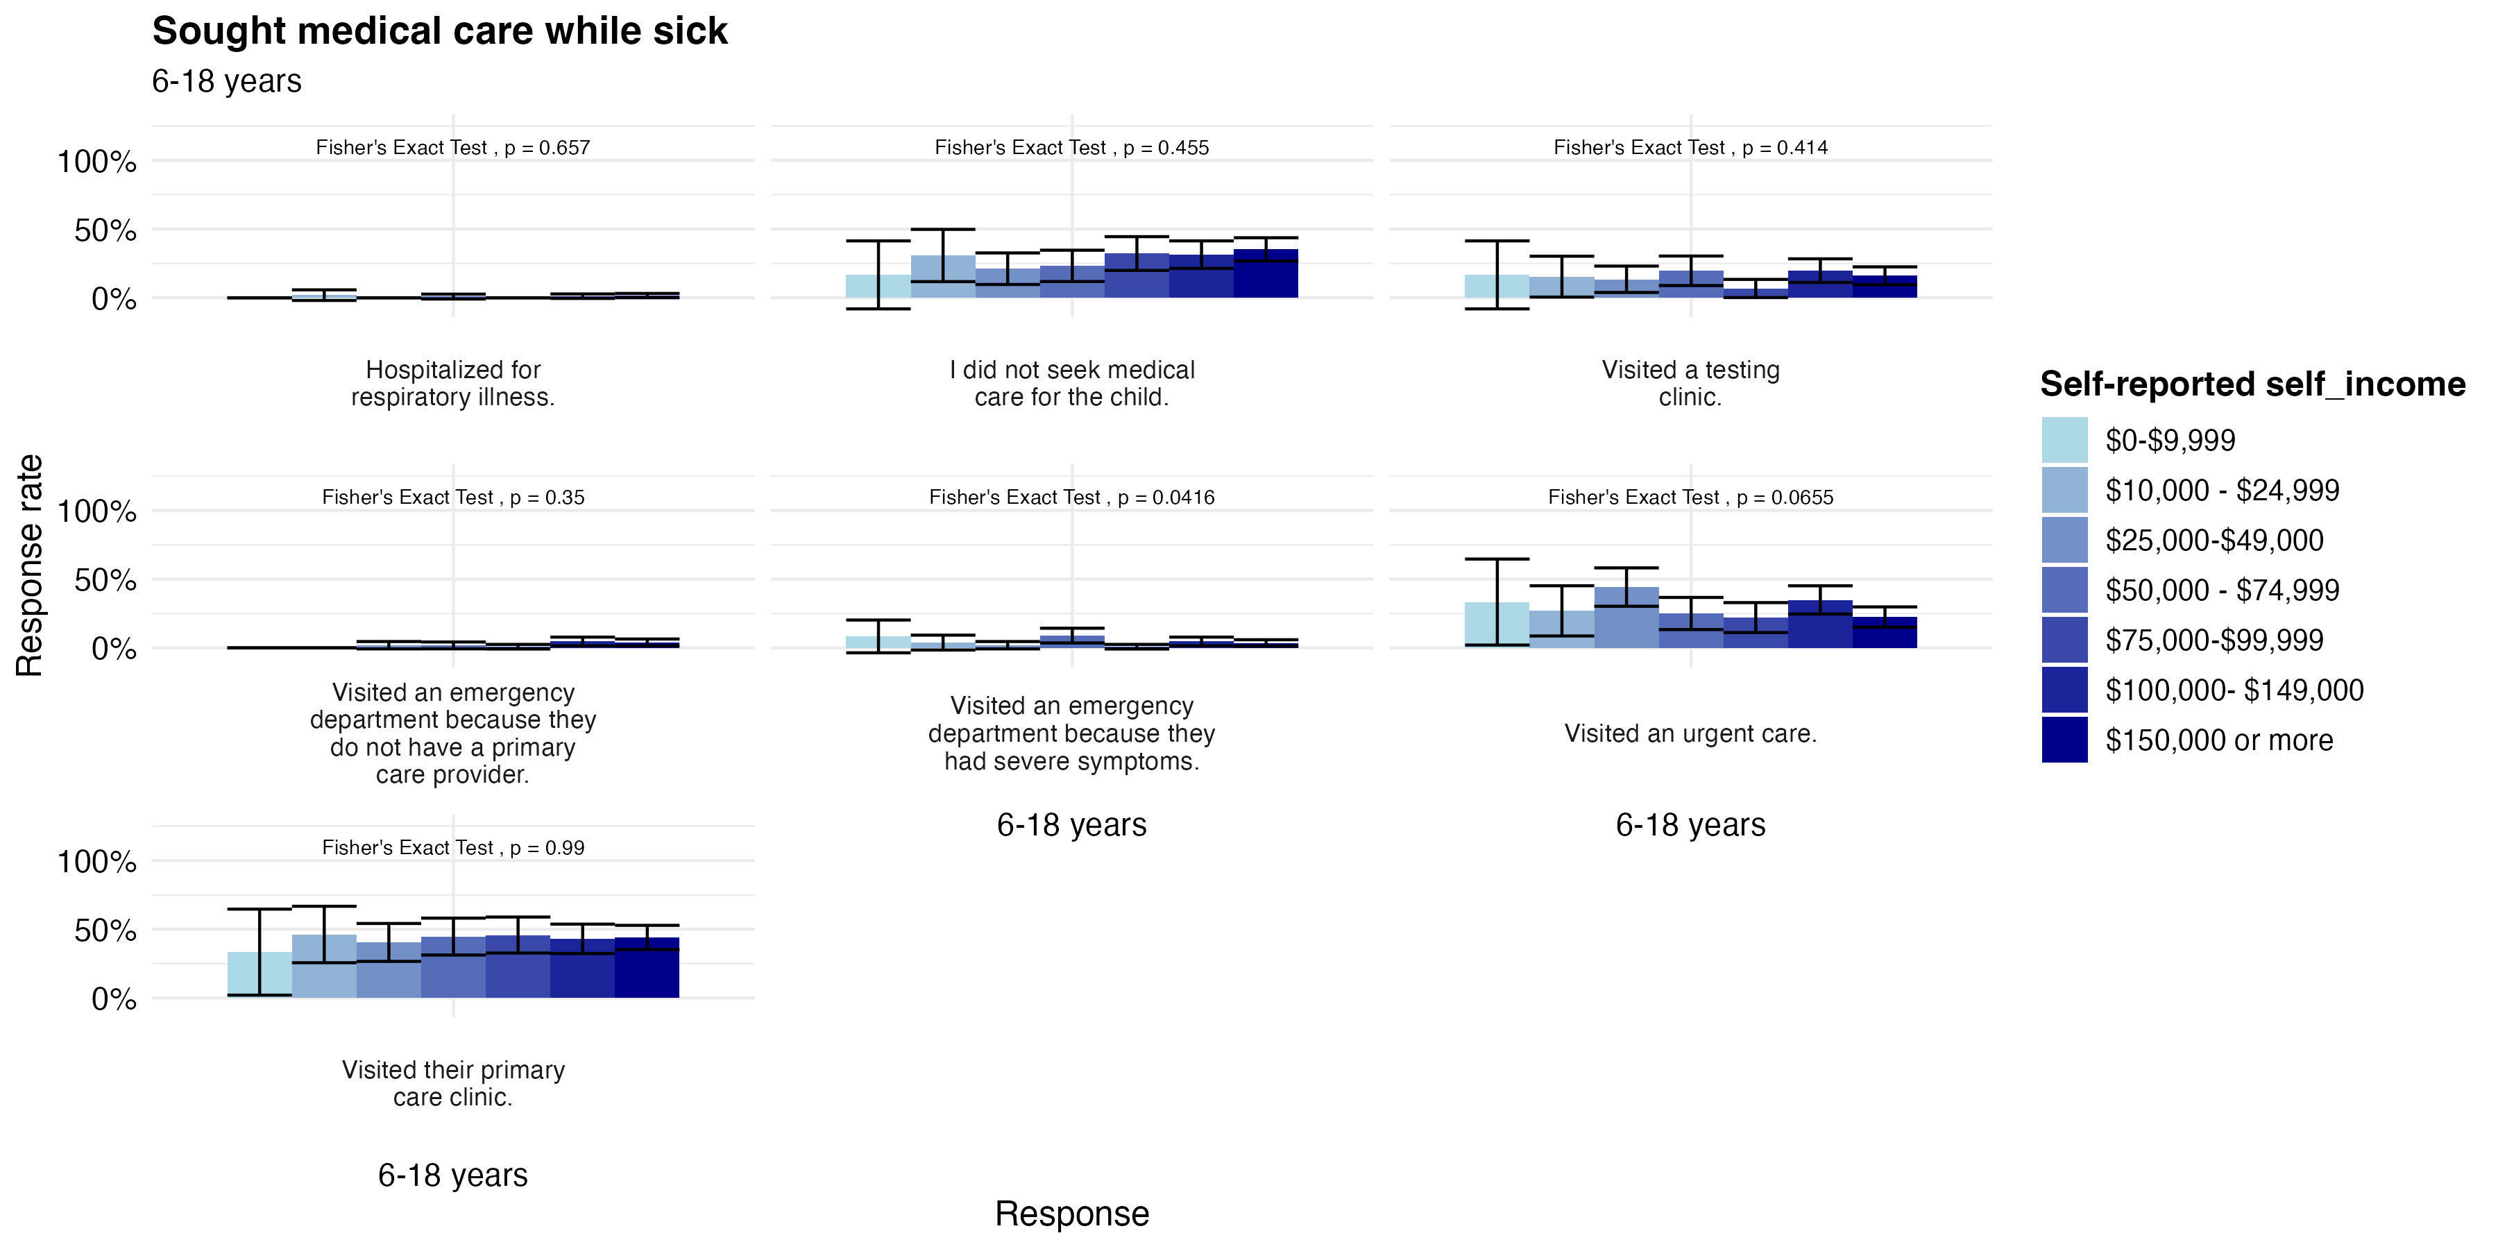
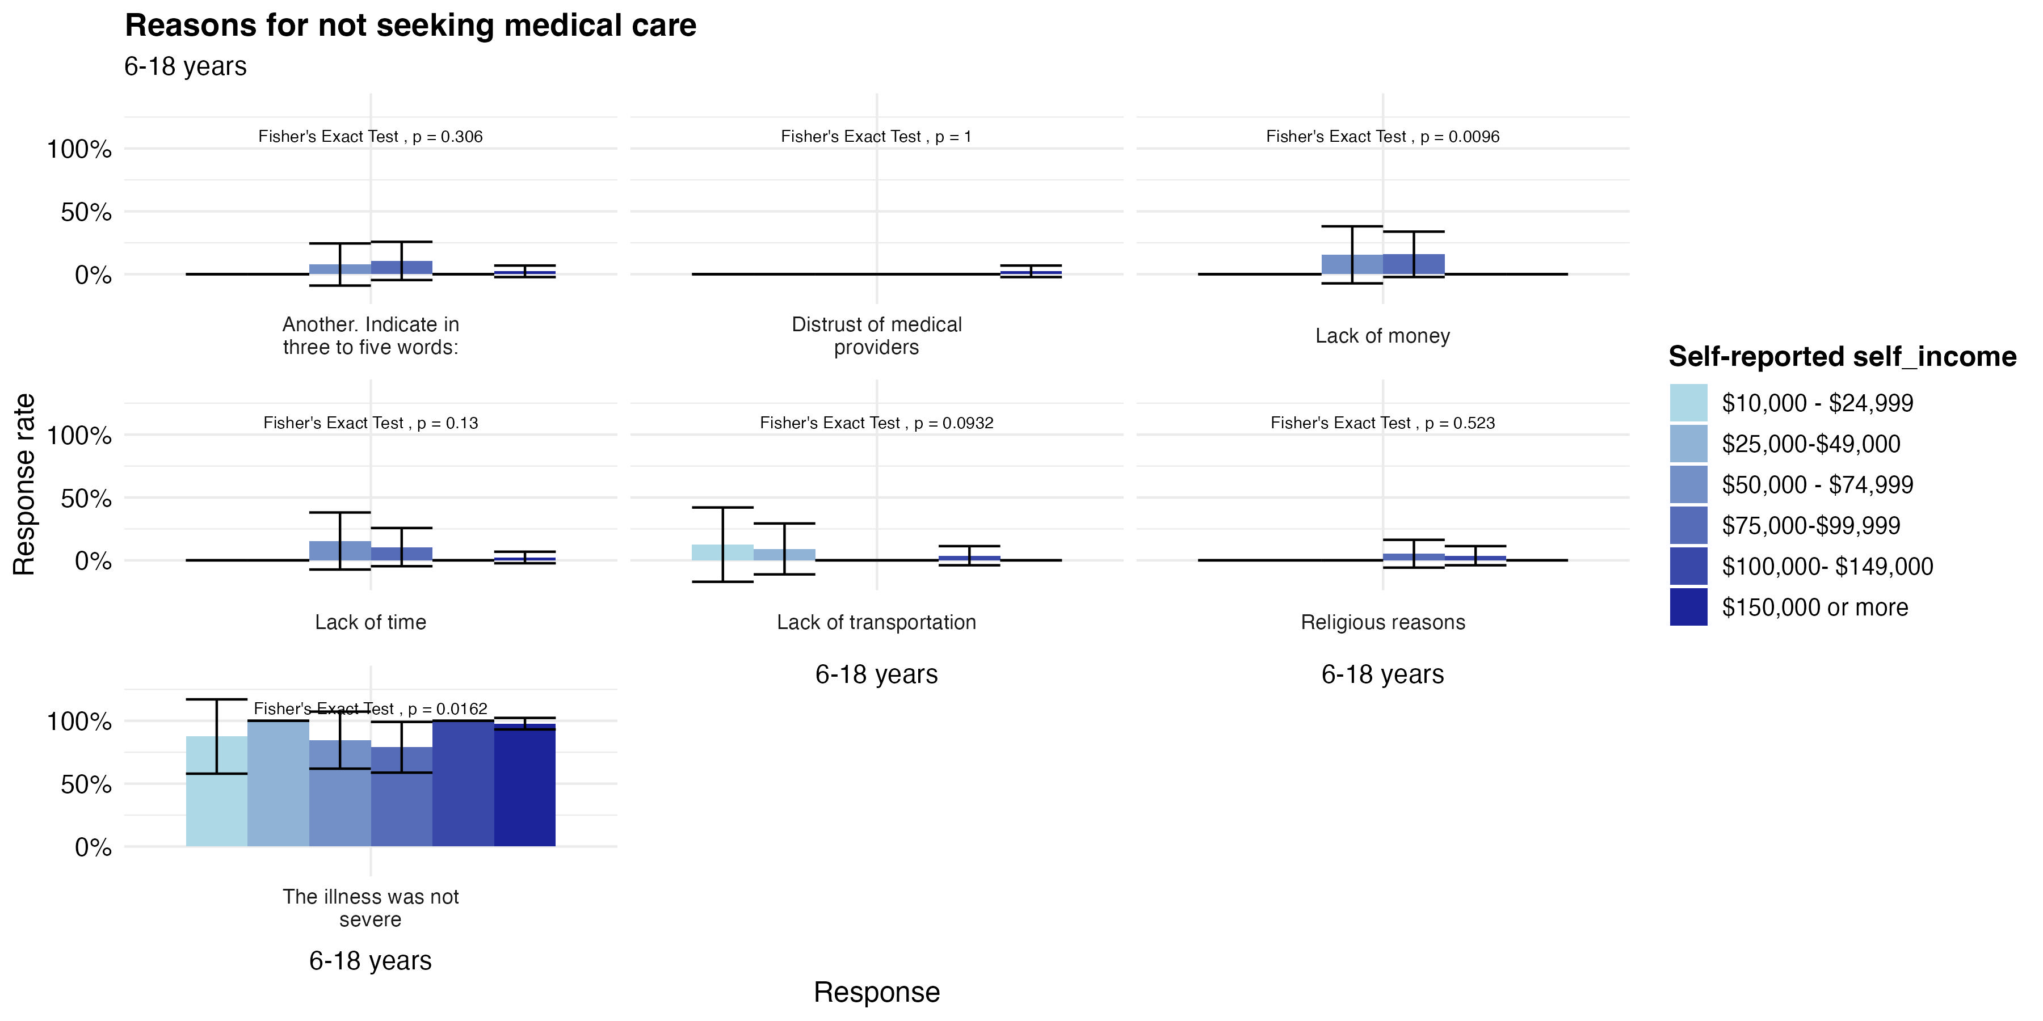
Did not Seek Medical Care
For the most part, we see that most people chose to not seek medical care because the illness was not severe
However, we do see small amounts of people within the lower income range of < 75k who were unable to go due to lack of money, time, or transportation

Slide 11
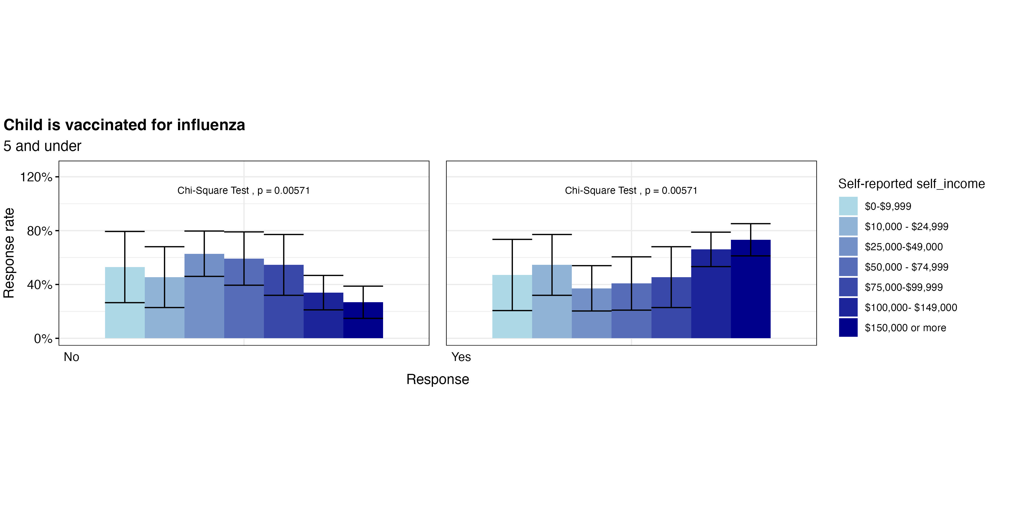

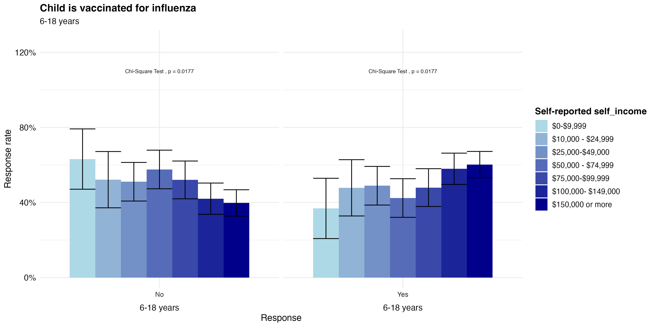
Influenza Vaccination Patterns
Among all Yes groups, we see that the highest income bracket has the highest proportion of vaccinated
In adults, it seems that there is a direct relationship between income and vaccination (Proportion for Yes increases with income, Proportion for No decreases with income)
See similar pattern for children 6-18
Overall, more children are vaccinated for influenza than COVID, but more adults are vaccinated for COVID than influenza

Slide 12
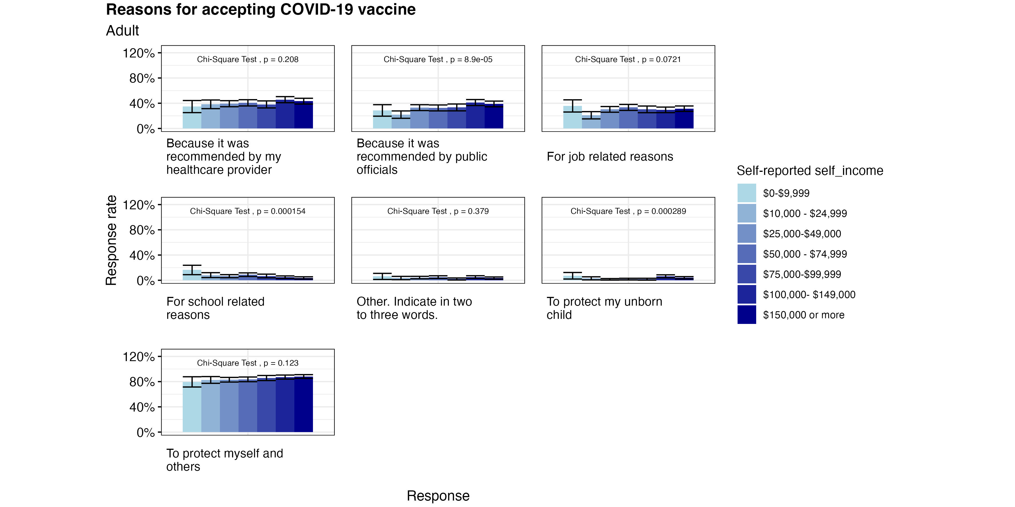
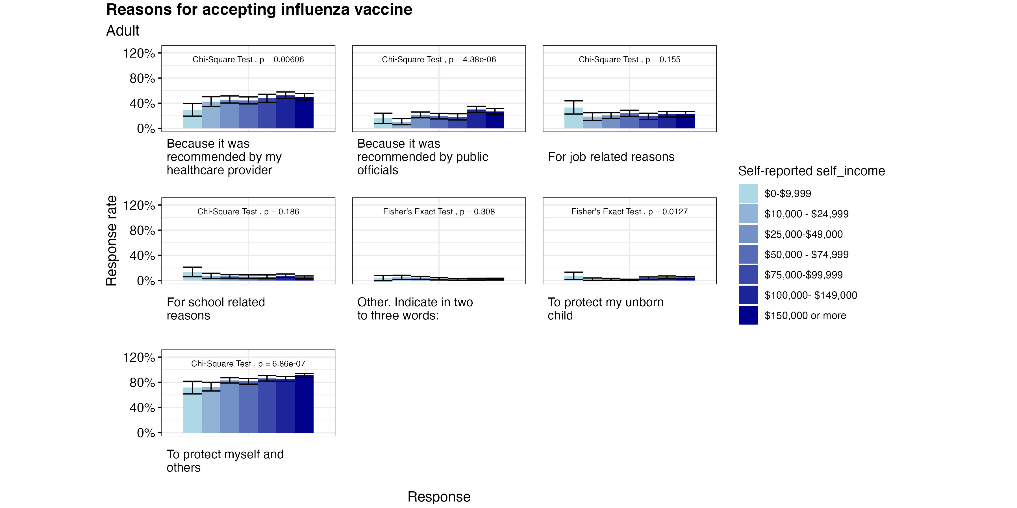
Accepting Vaccines Among Adults
Among all income levels, it is unanimous that most people are getting these vaccines to protect themselves
We see a positive trend with having recommendations from a healthcare provider and income level

Slide 13
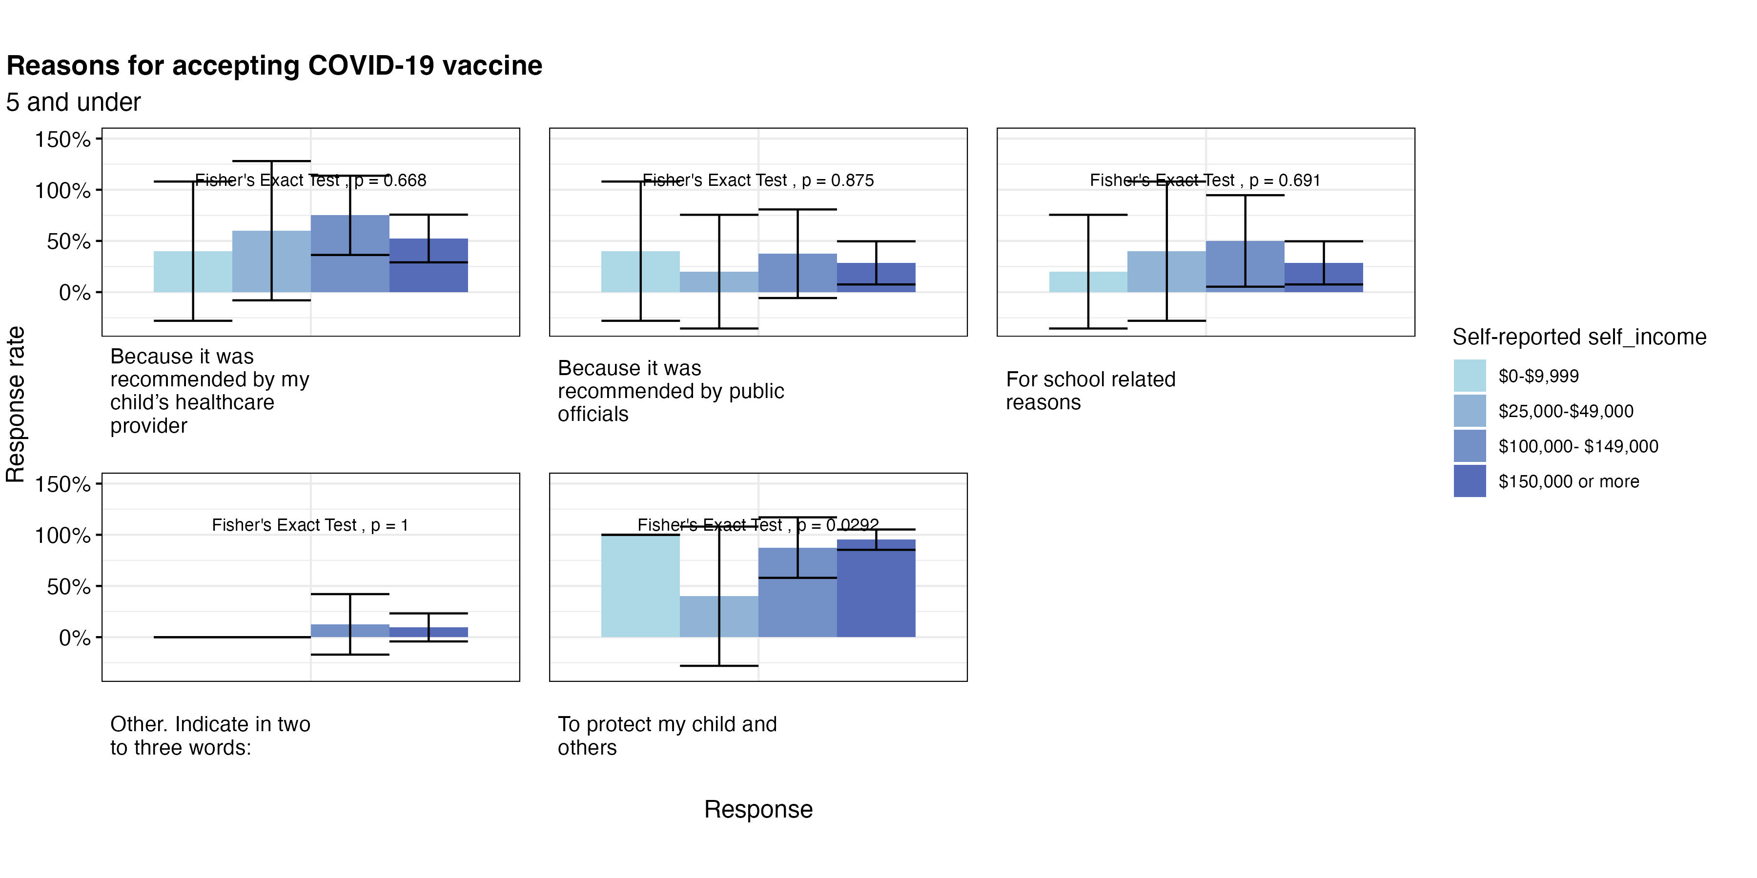
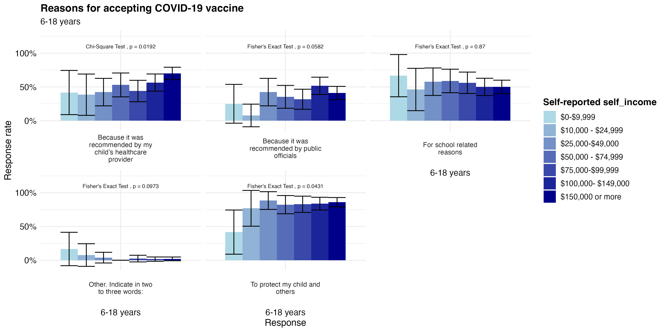
Accepting COVID-19 Vaccine Among Children
For most income levels, the predominant reasons for vaccination are protecting their child. For the lowest income, many chose to vaccinate due to school requirements.

Slide 14
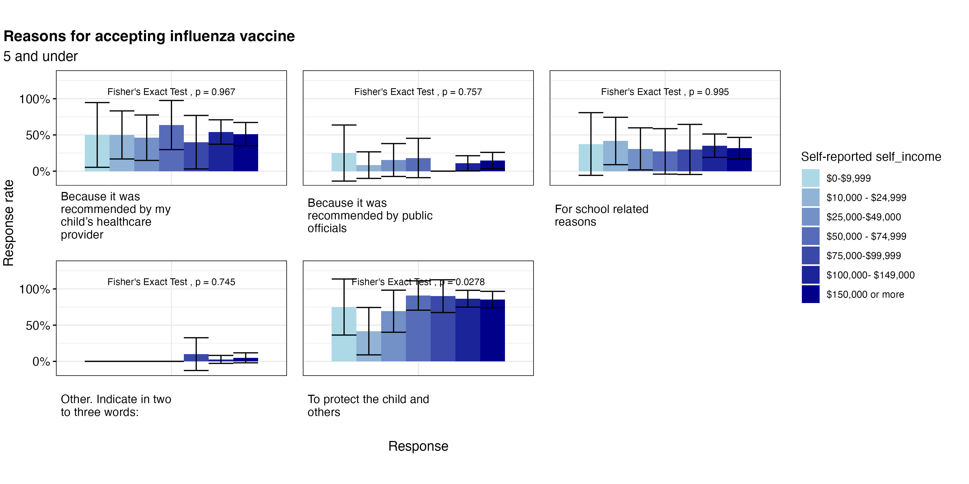
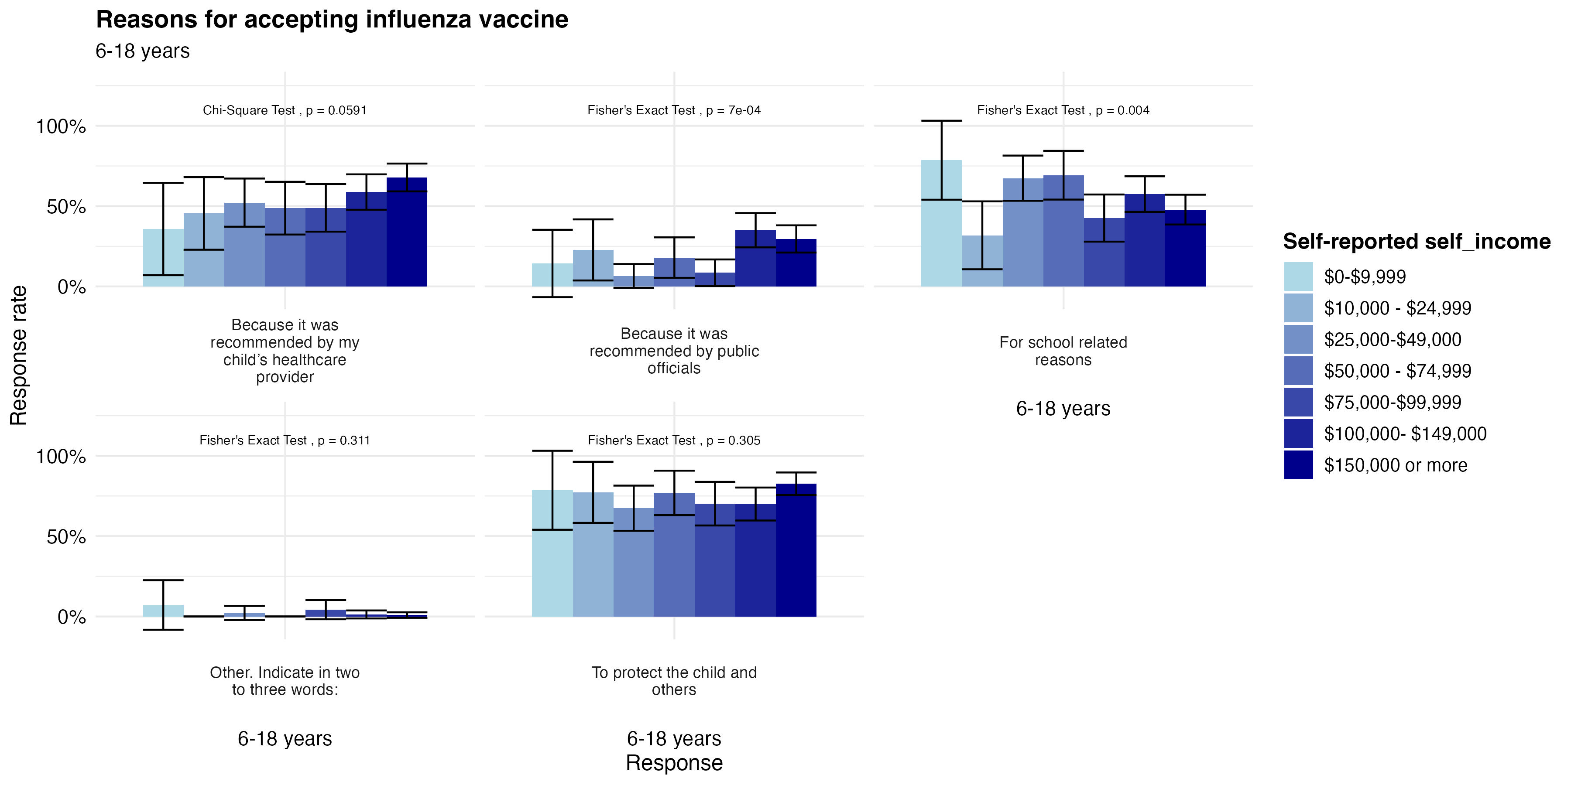
Accepting Influenza Vaccine Among Children
Among older children, we see a positive relationship between recommendation from healthcare provider and income level
Across all income levels, protecting the child remains a top priority

Slide 15
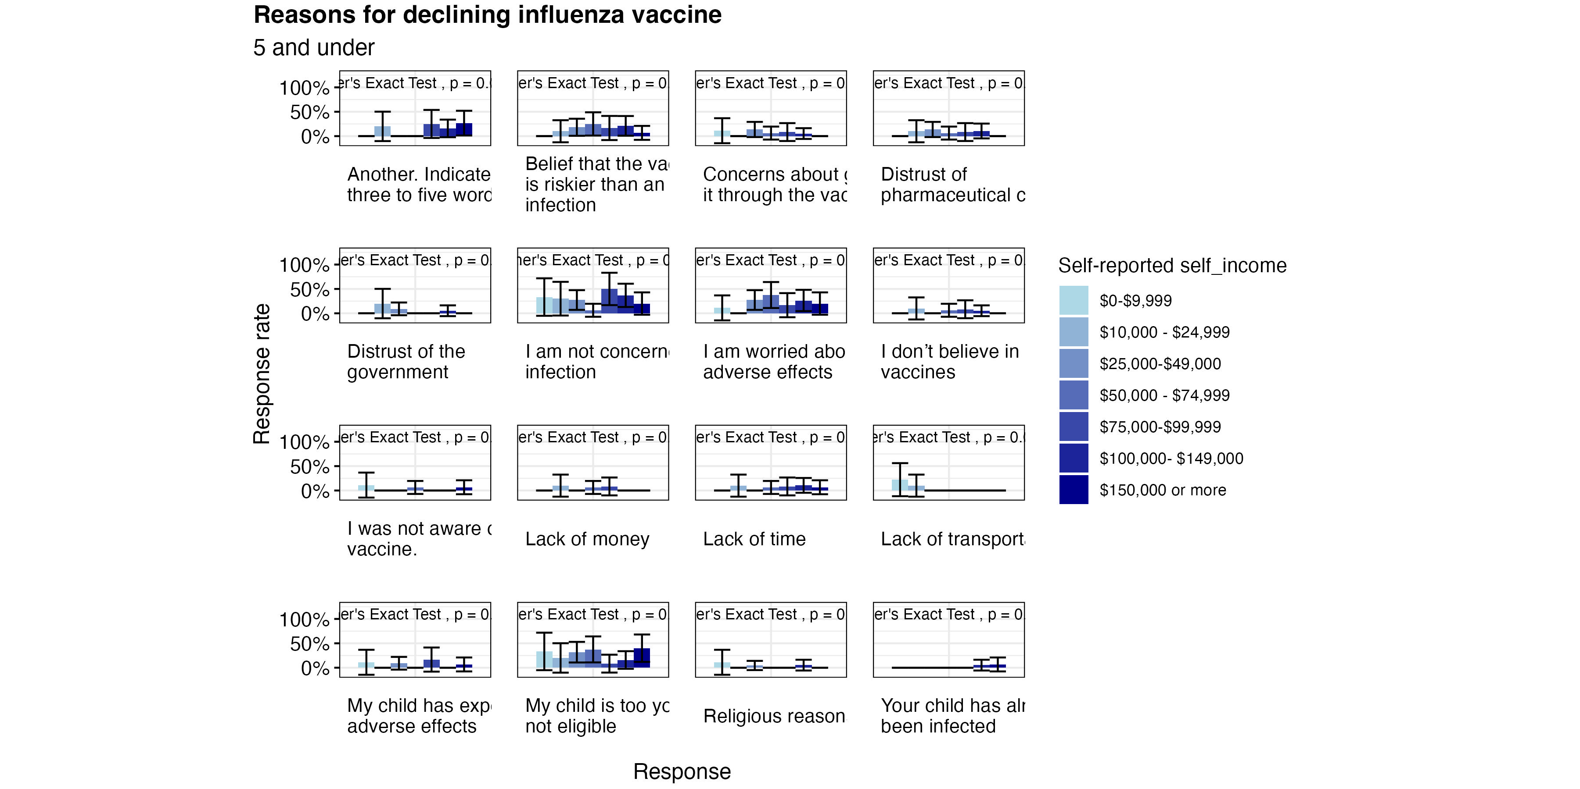
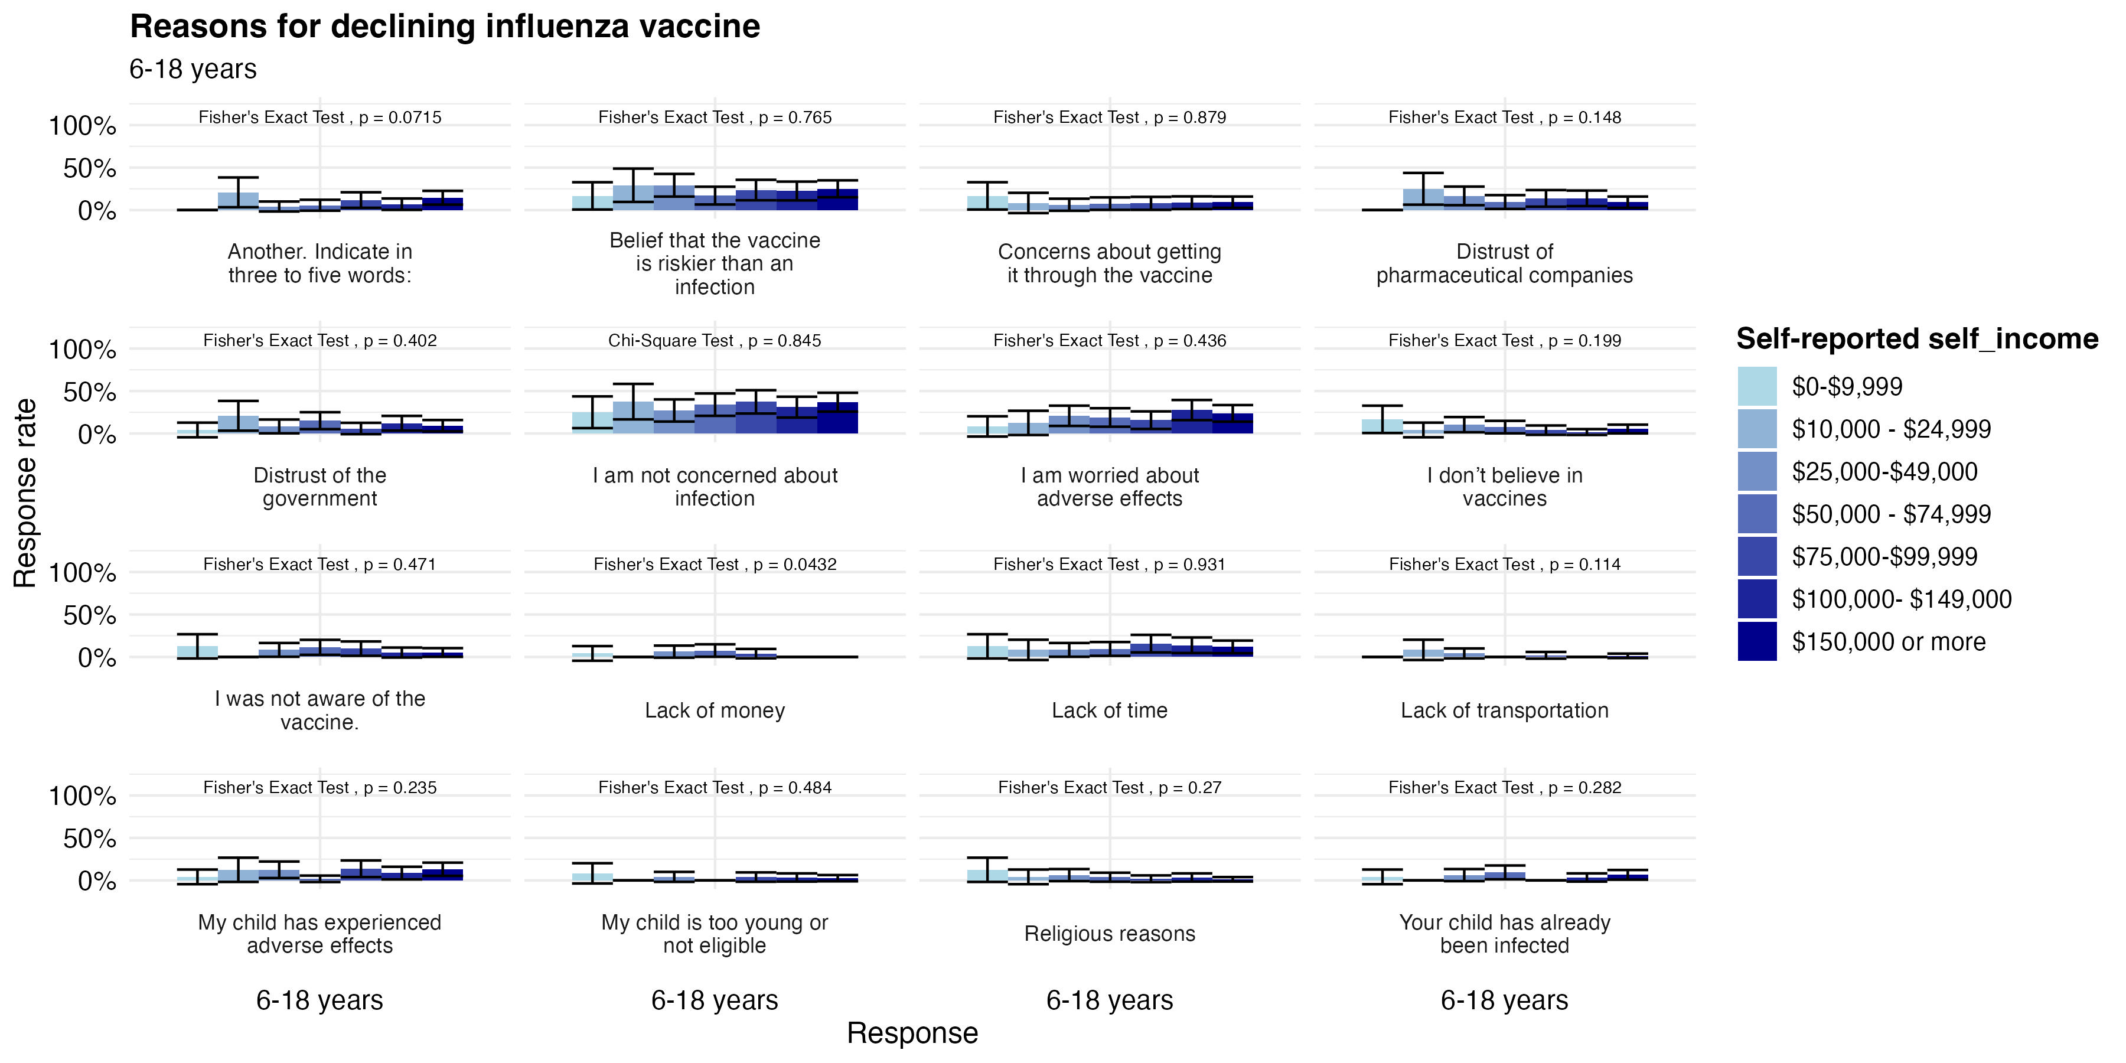
Declining Influenza Vaccine Among Children
For influenza, we also see a large amount who are not concerned about infection among all income levels
Among low income groups, we see a larger amount of concerns about pharmaceutical companies, getting flu from the vaccine

Slide 16
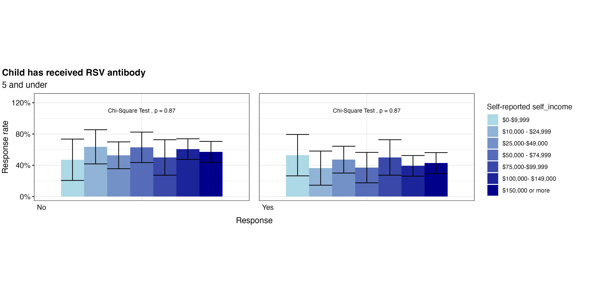
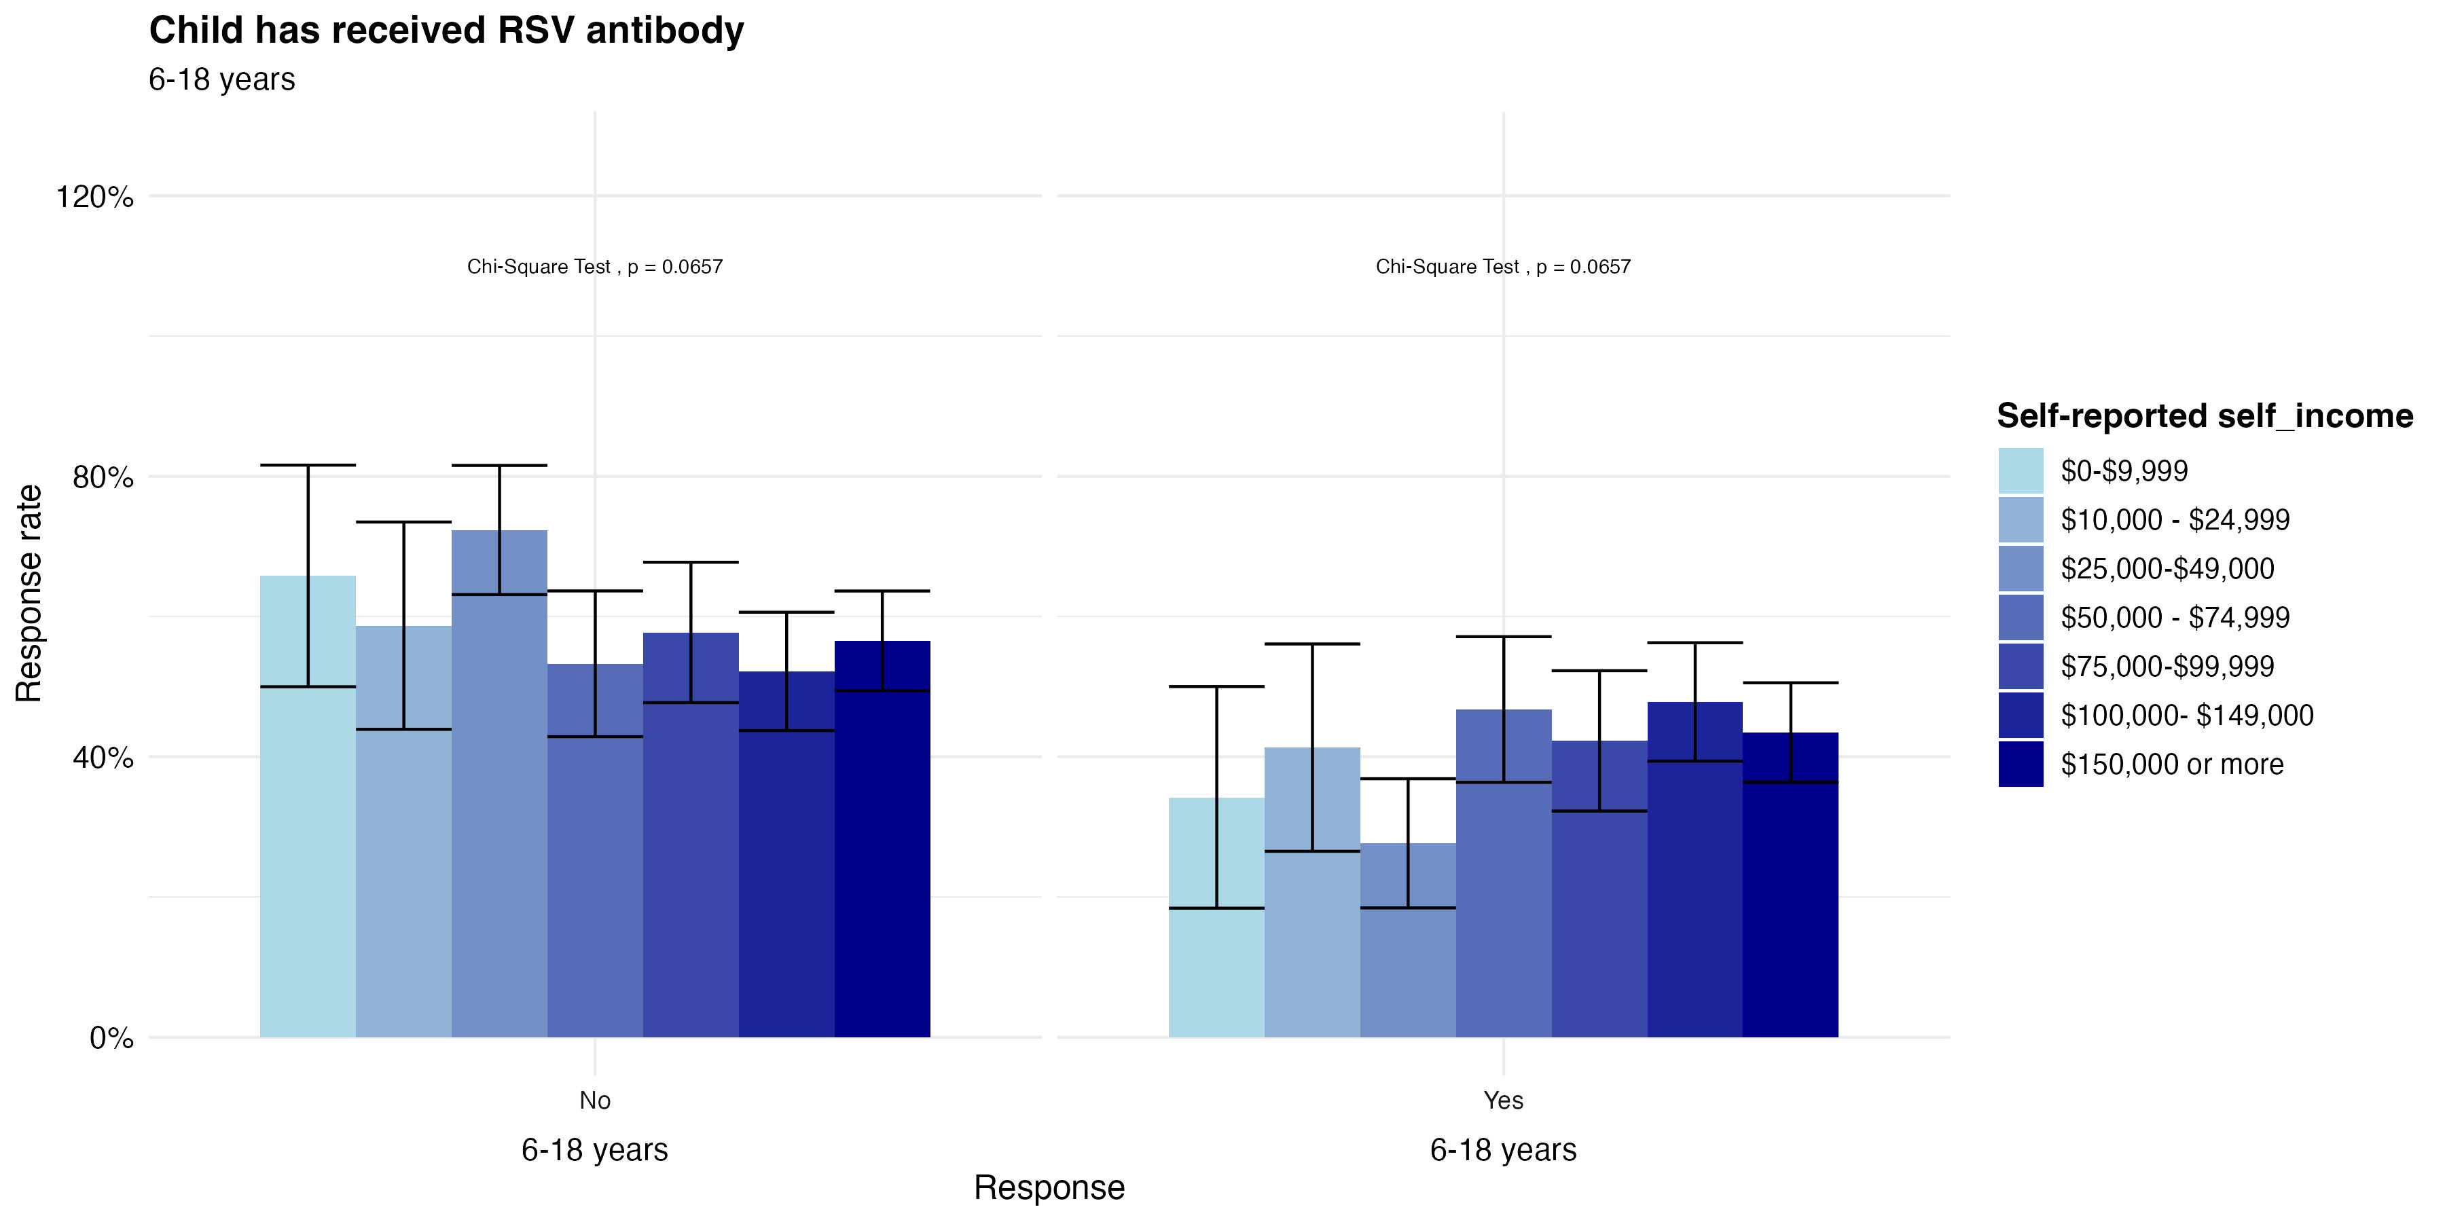
RSV Vaccination Patterns
Among all income levels, more children have not received the RSV antibody than who have

Slide 17
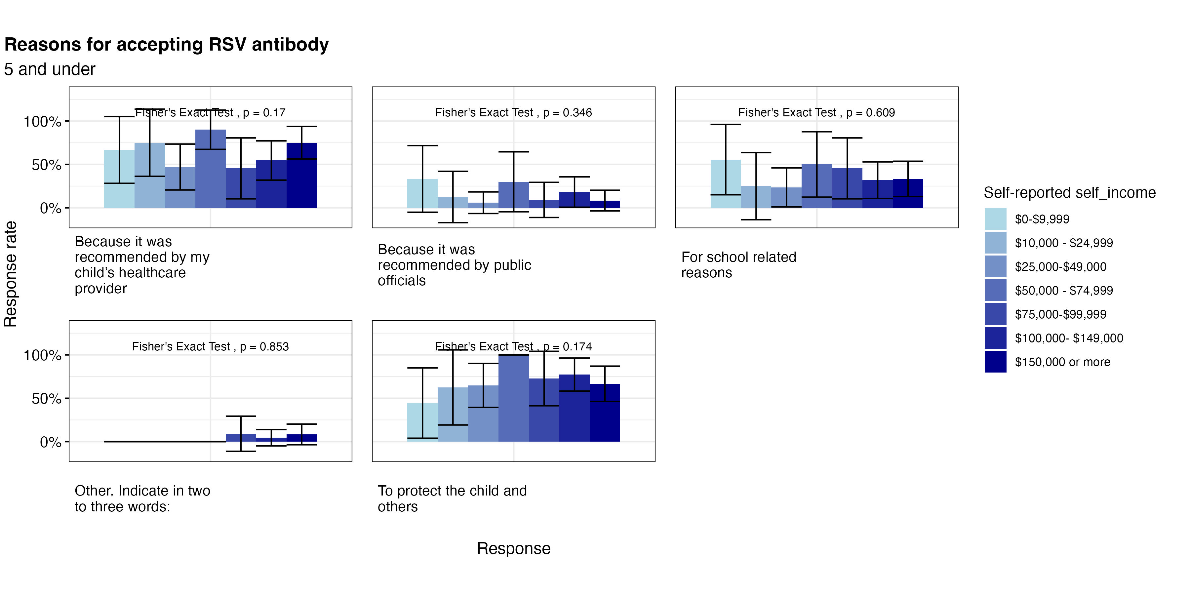
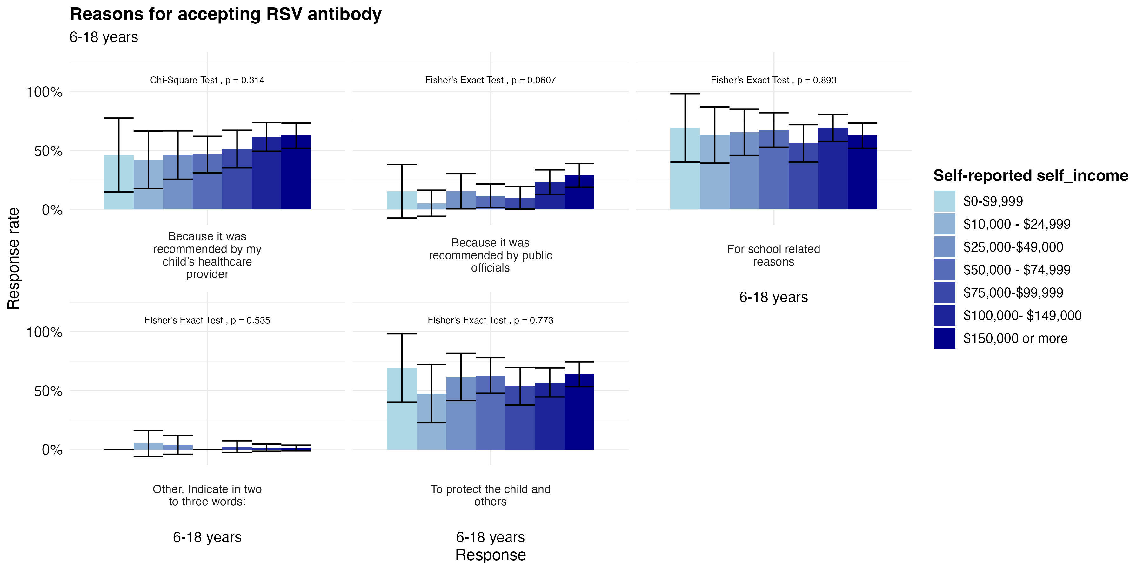
Accepting RSV Antibody
We see RSV Antibody acceptance due to school requirements and healthcare provider recommendations among all income levels

Slide 18
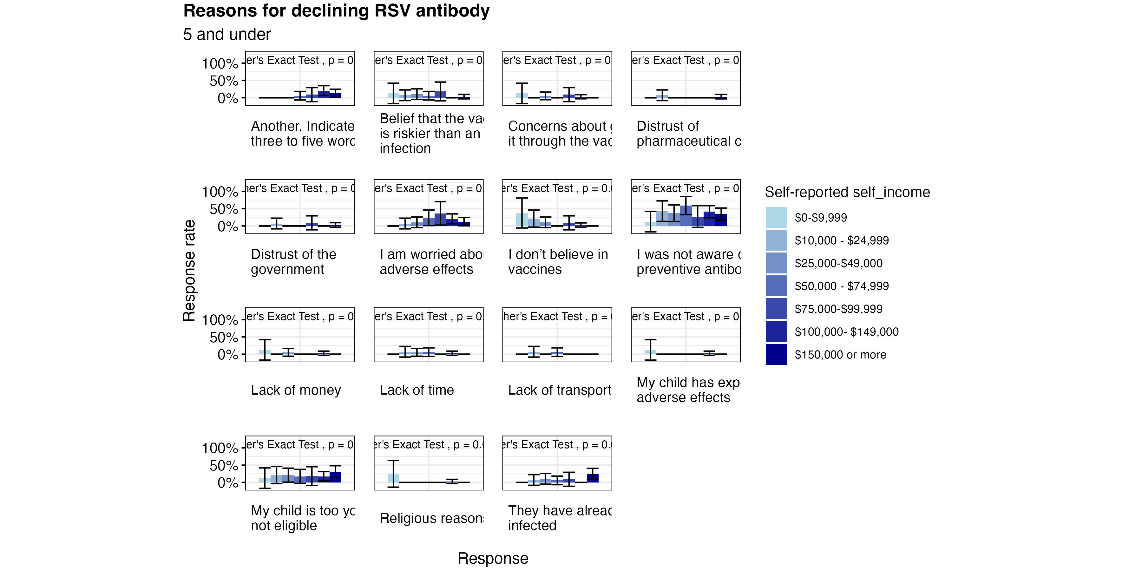
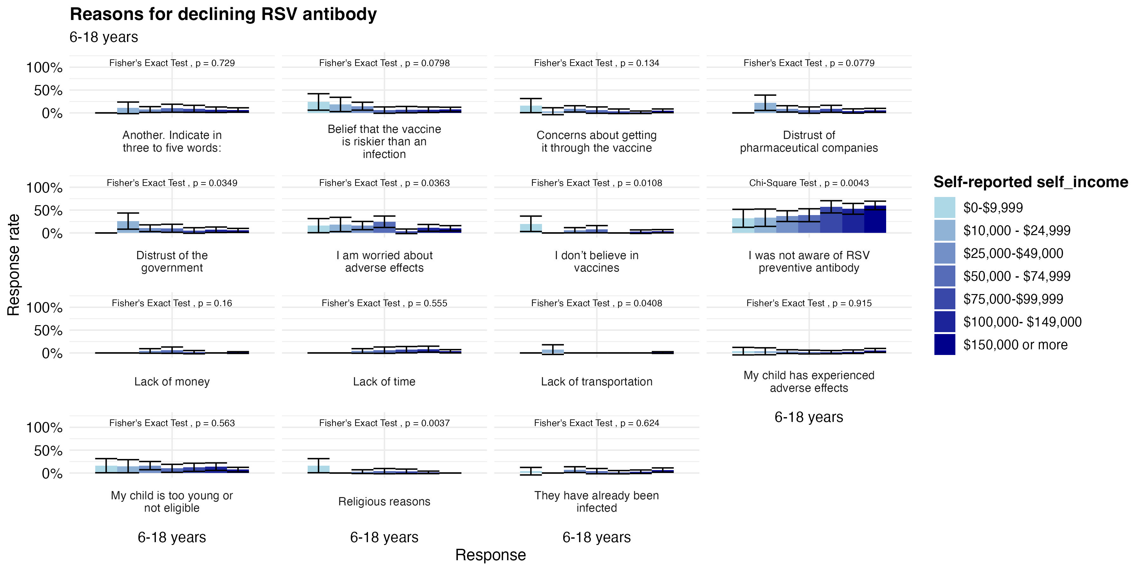
Declining RSV Antibody
We see a strong lack of awareness about RSV antibodies across all income levels

Slide 19
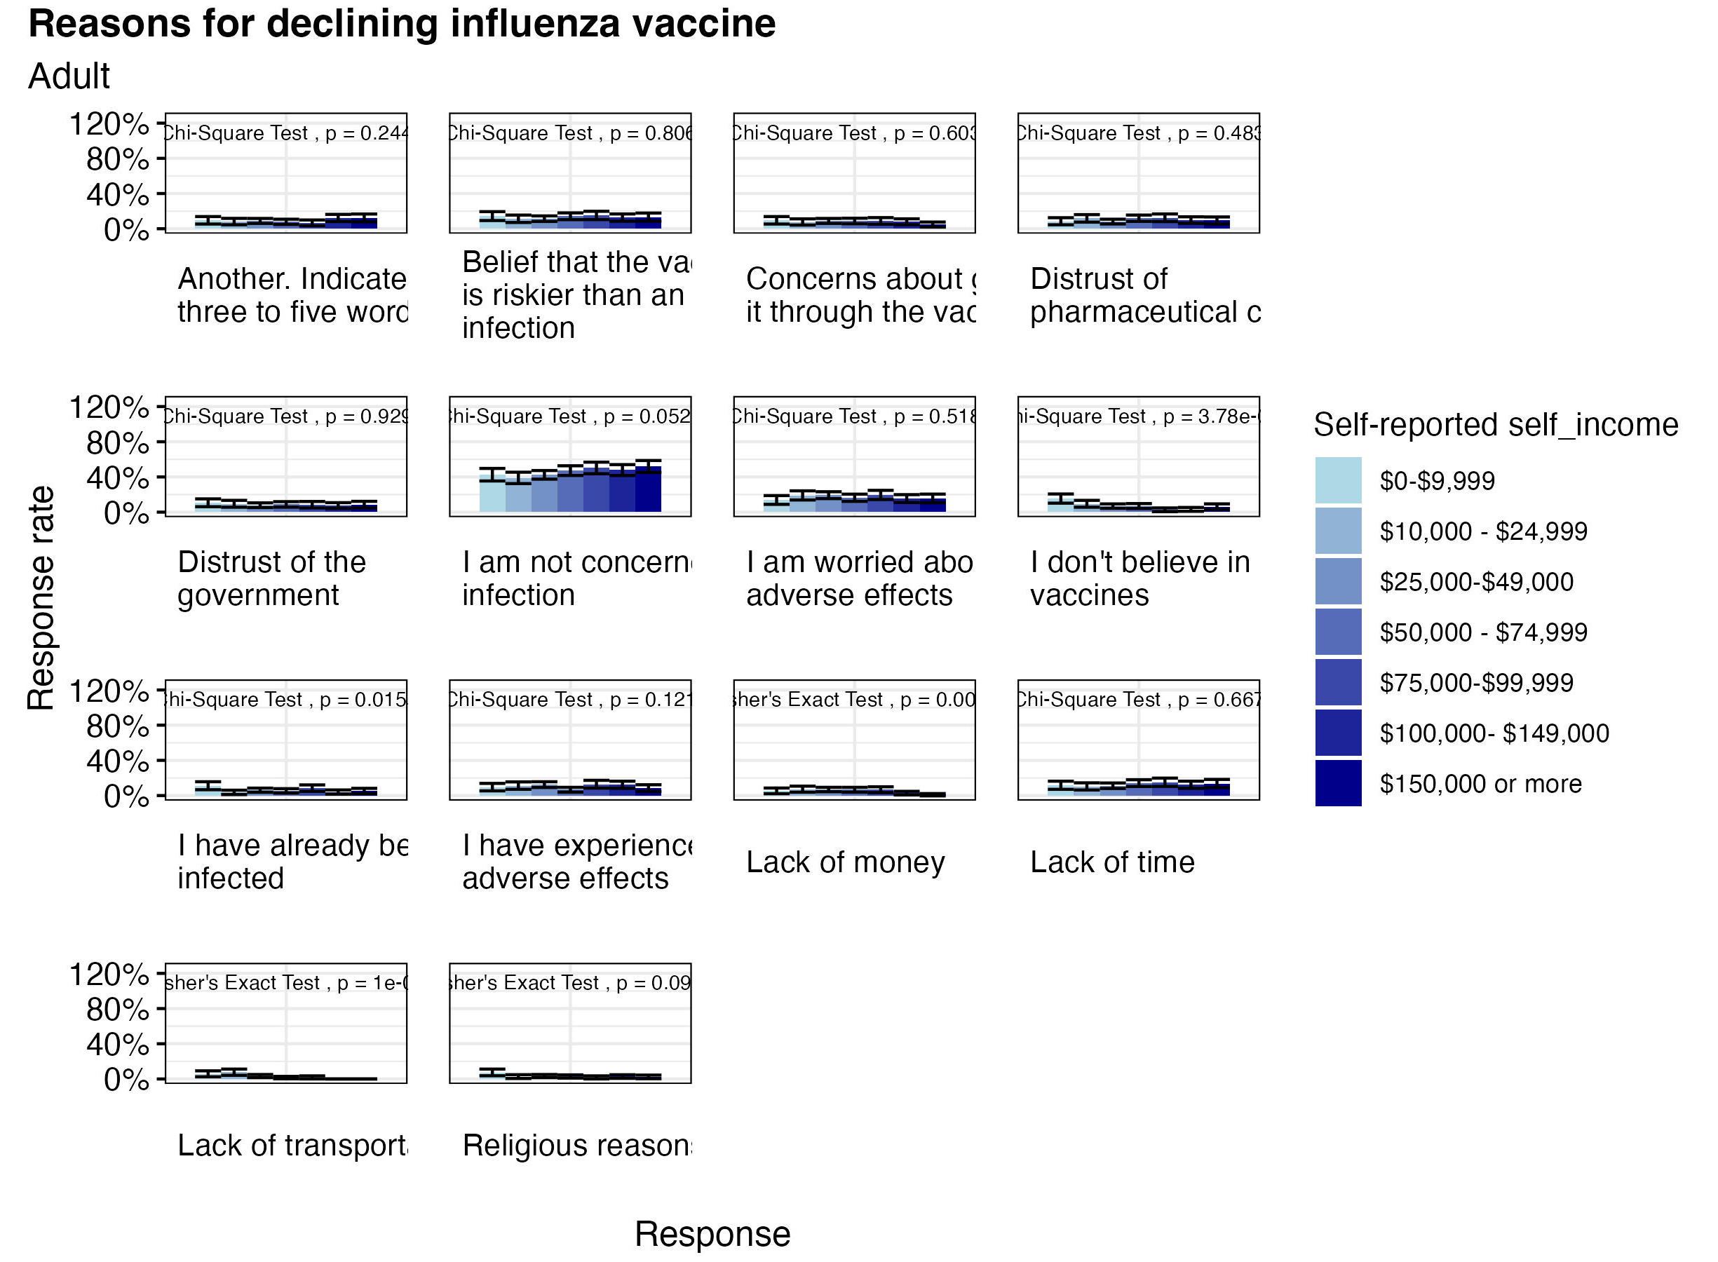
Adults: Declining Influenza Vaccine
Among all income levels, the main reason adults are not getting a flu vaccine is because they are not concerned about infection
Among all income levels, we see a small amount of participants who are more hesitant about the vaccine and its potential harmful effects

Slide 20
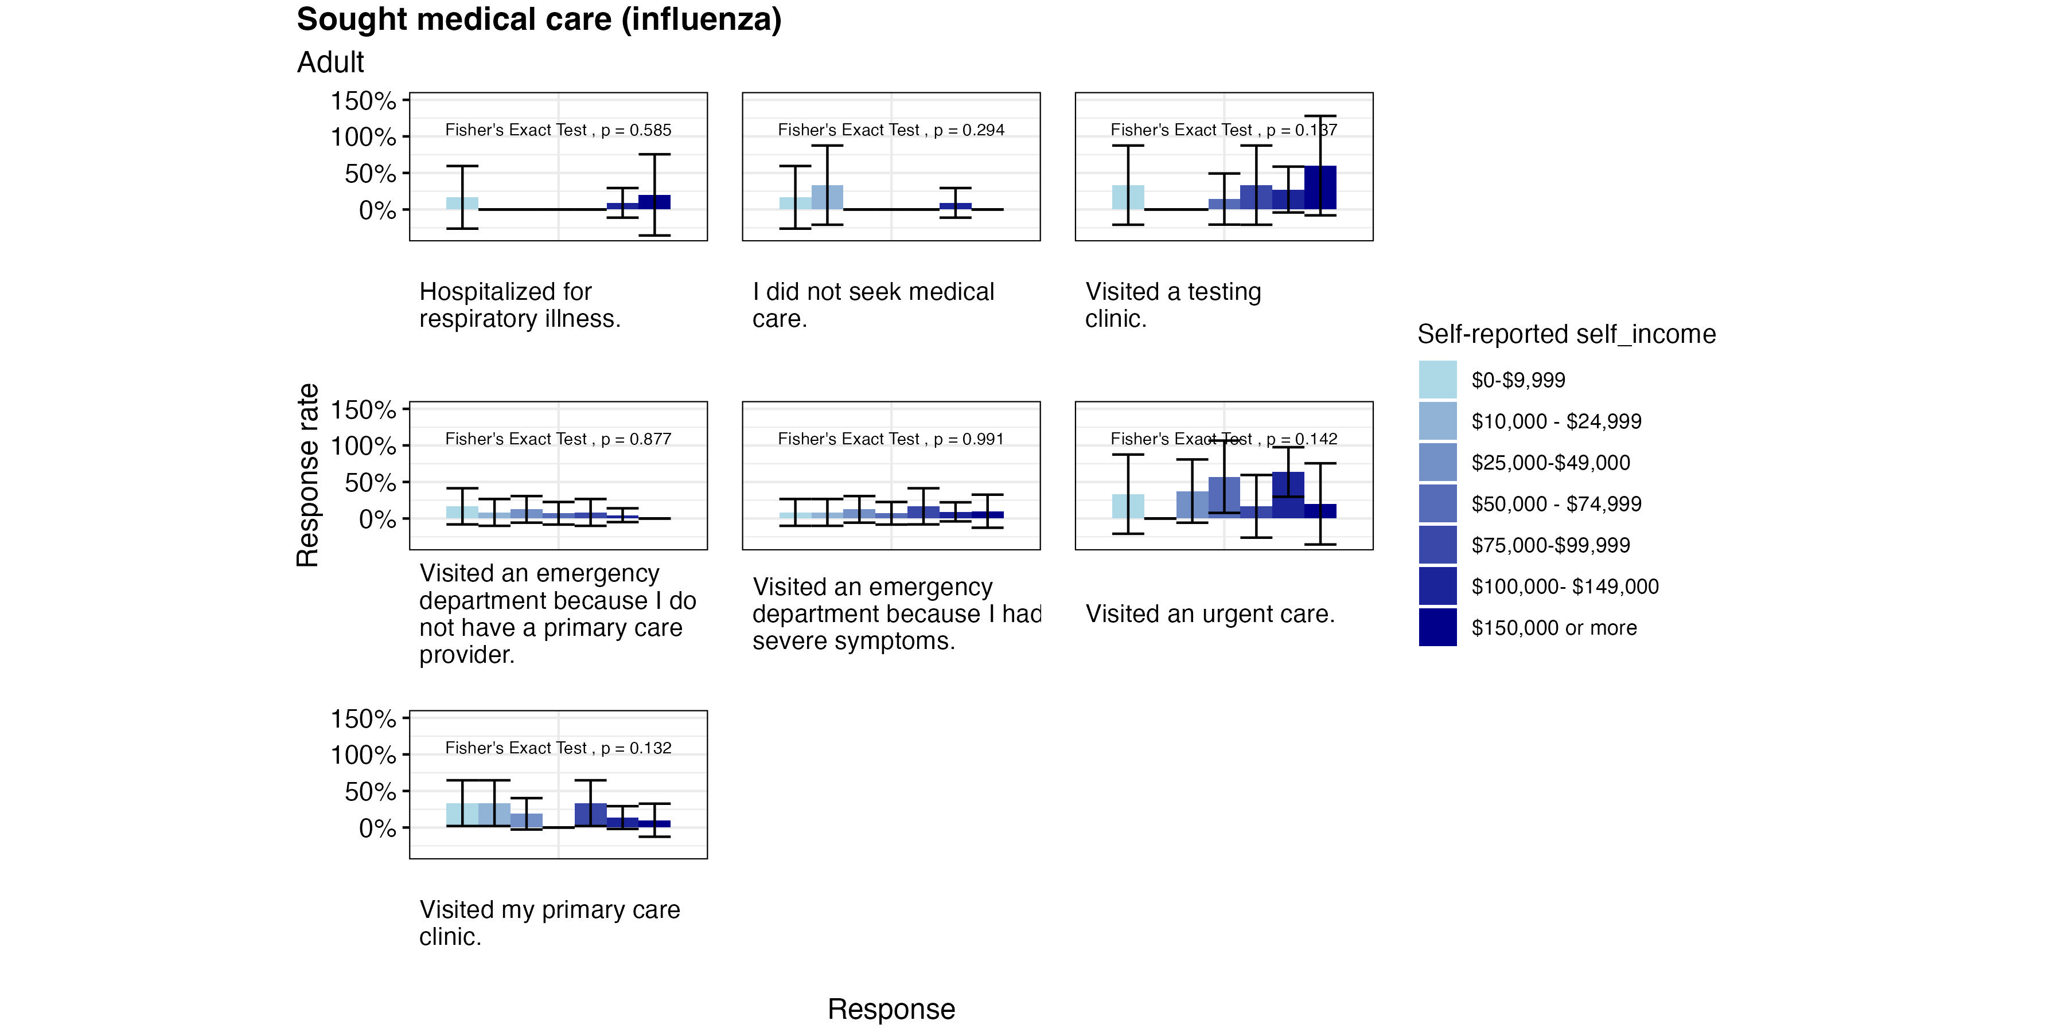
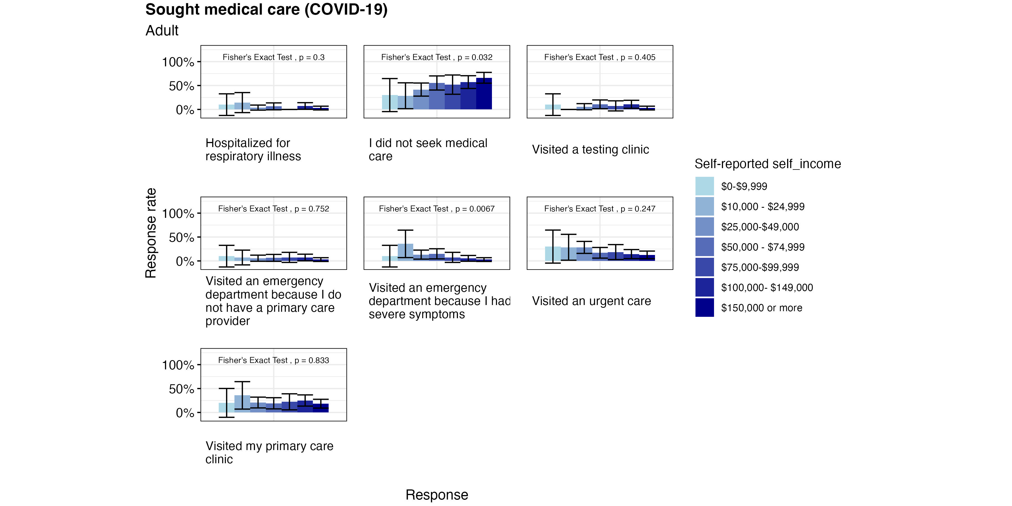
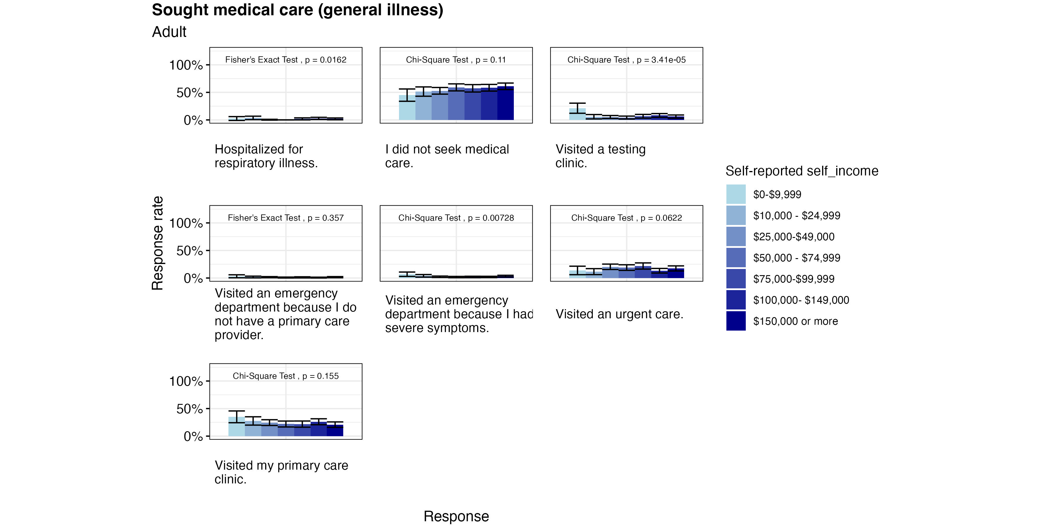
Sought Medical Care (Adult)

Slide 21
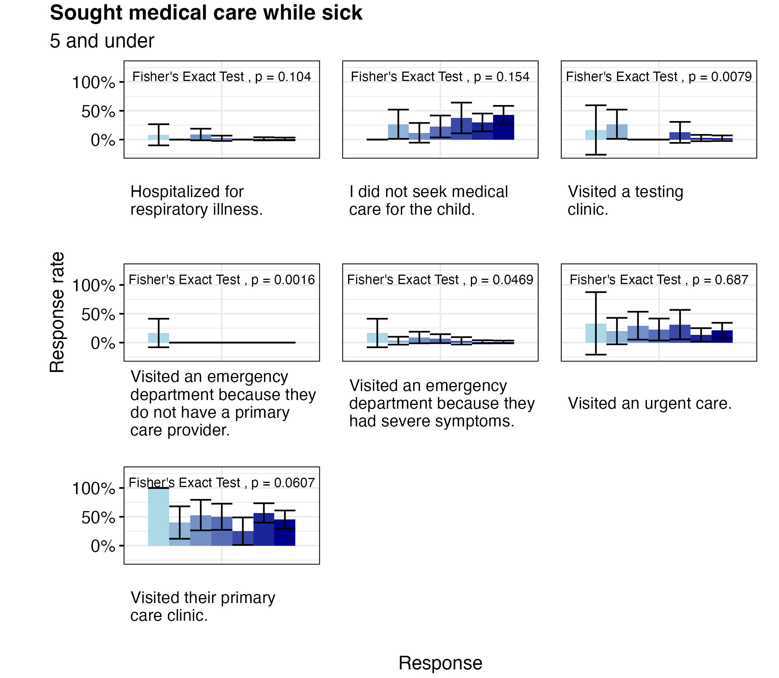
Sought Medical Care (Children)

Slide 22
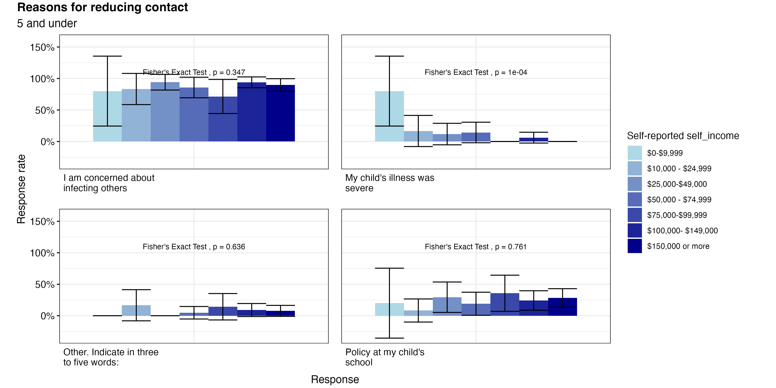
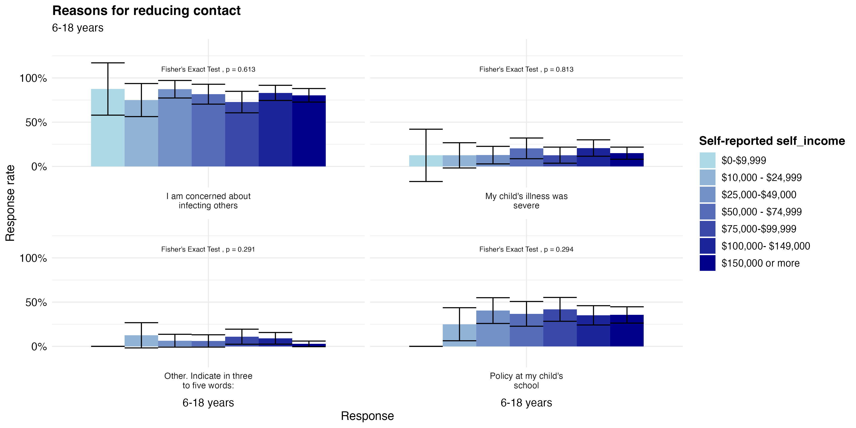
Reducing Contact (Children)

Slide 23
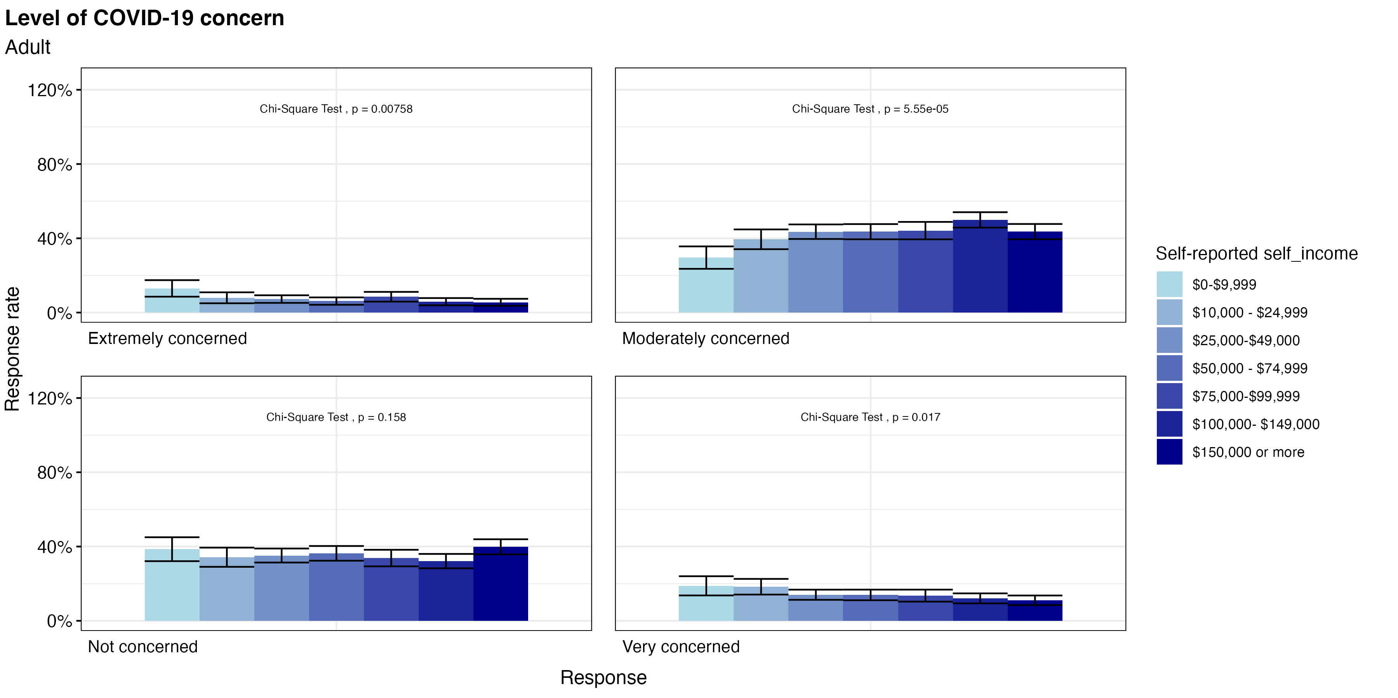
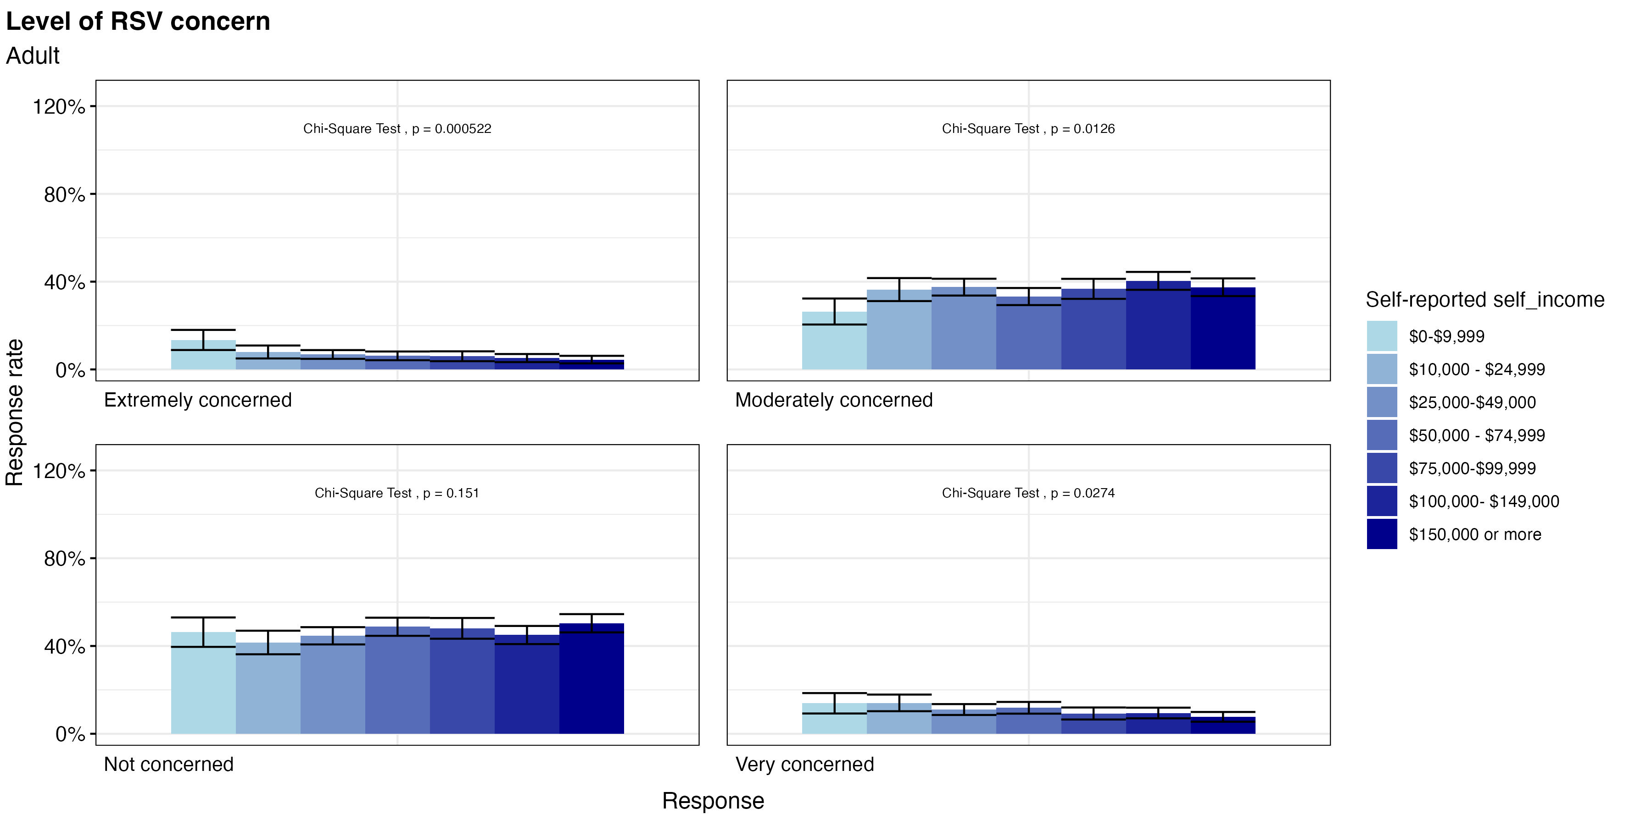
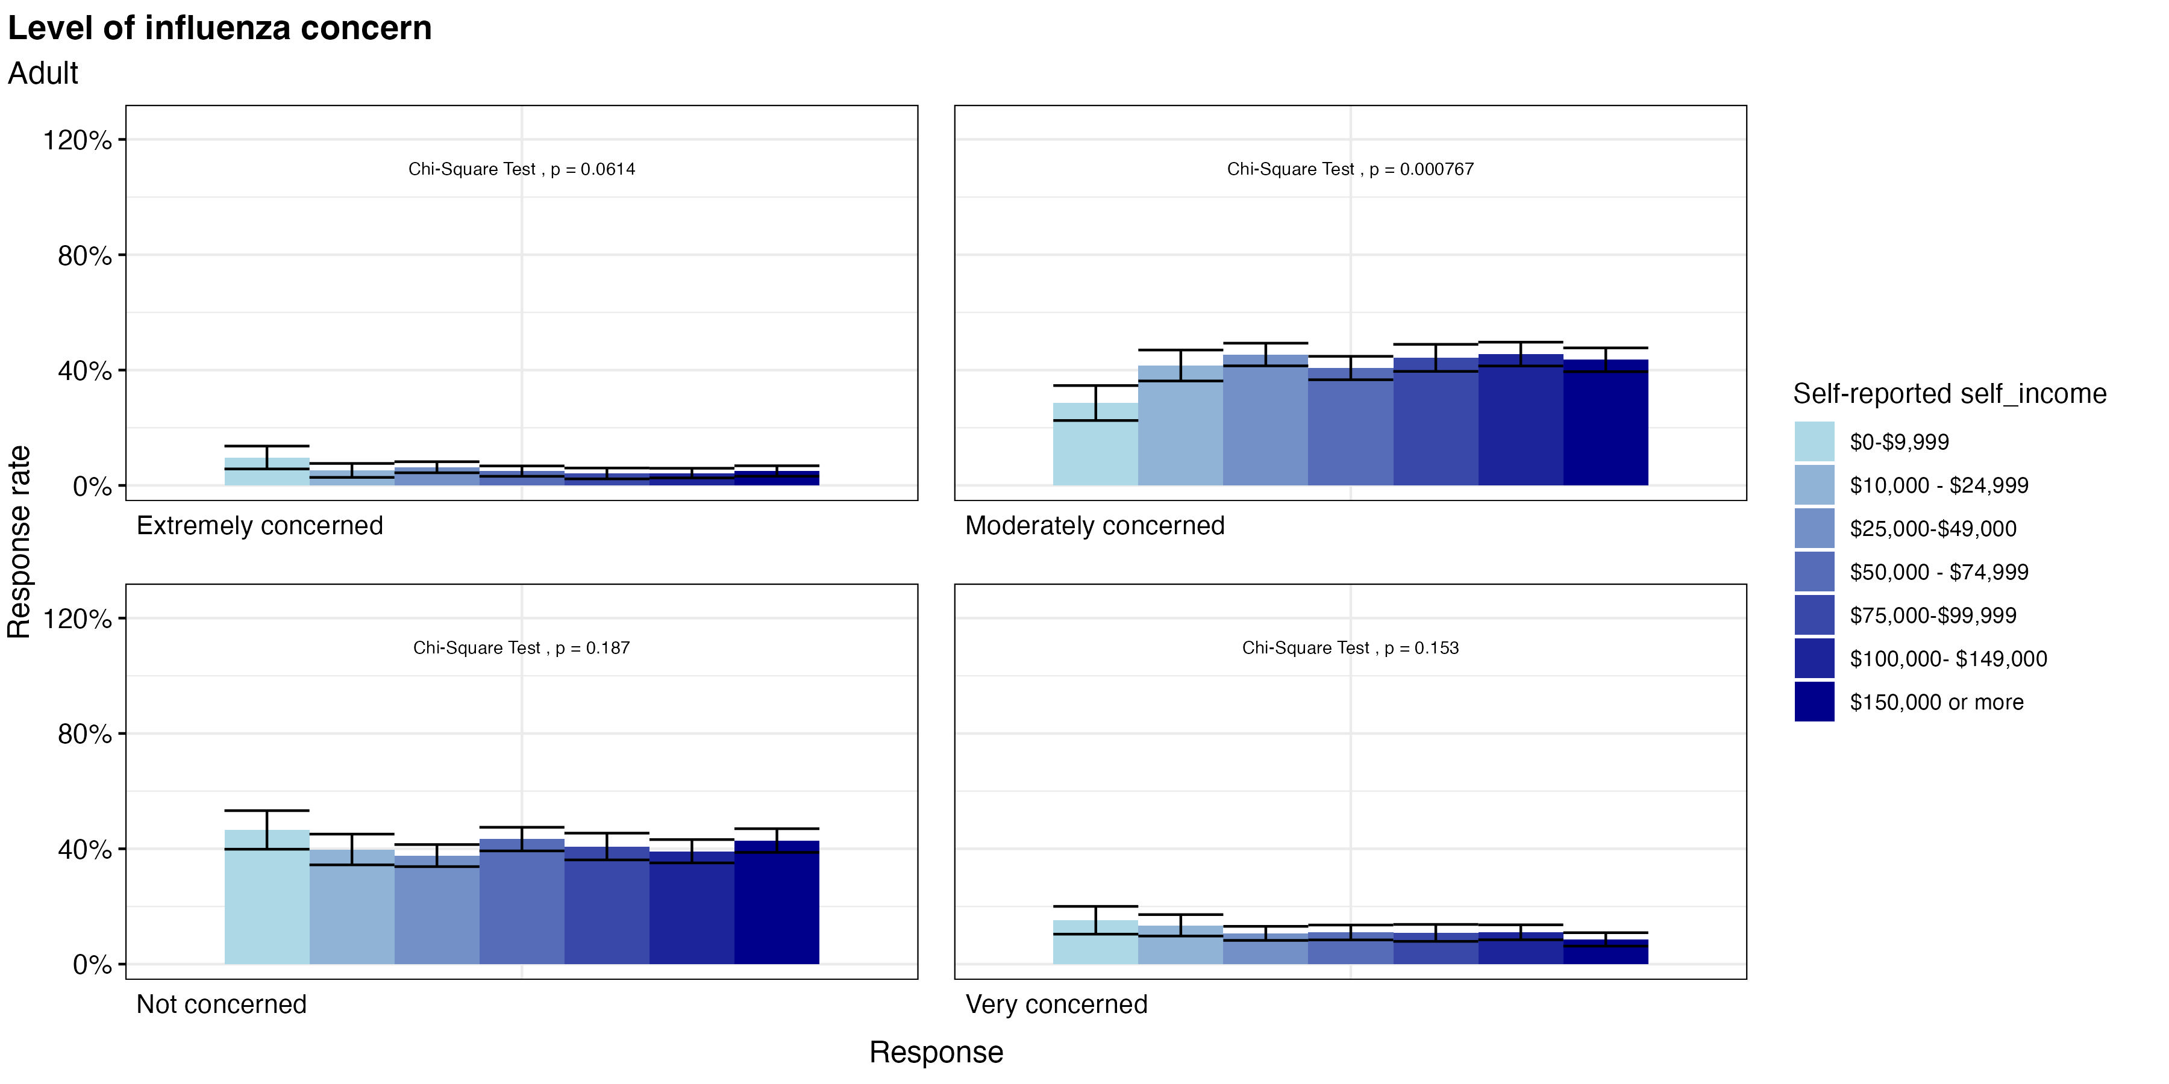
Disease Concern Among Adults

Slide 24
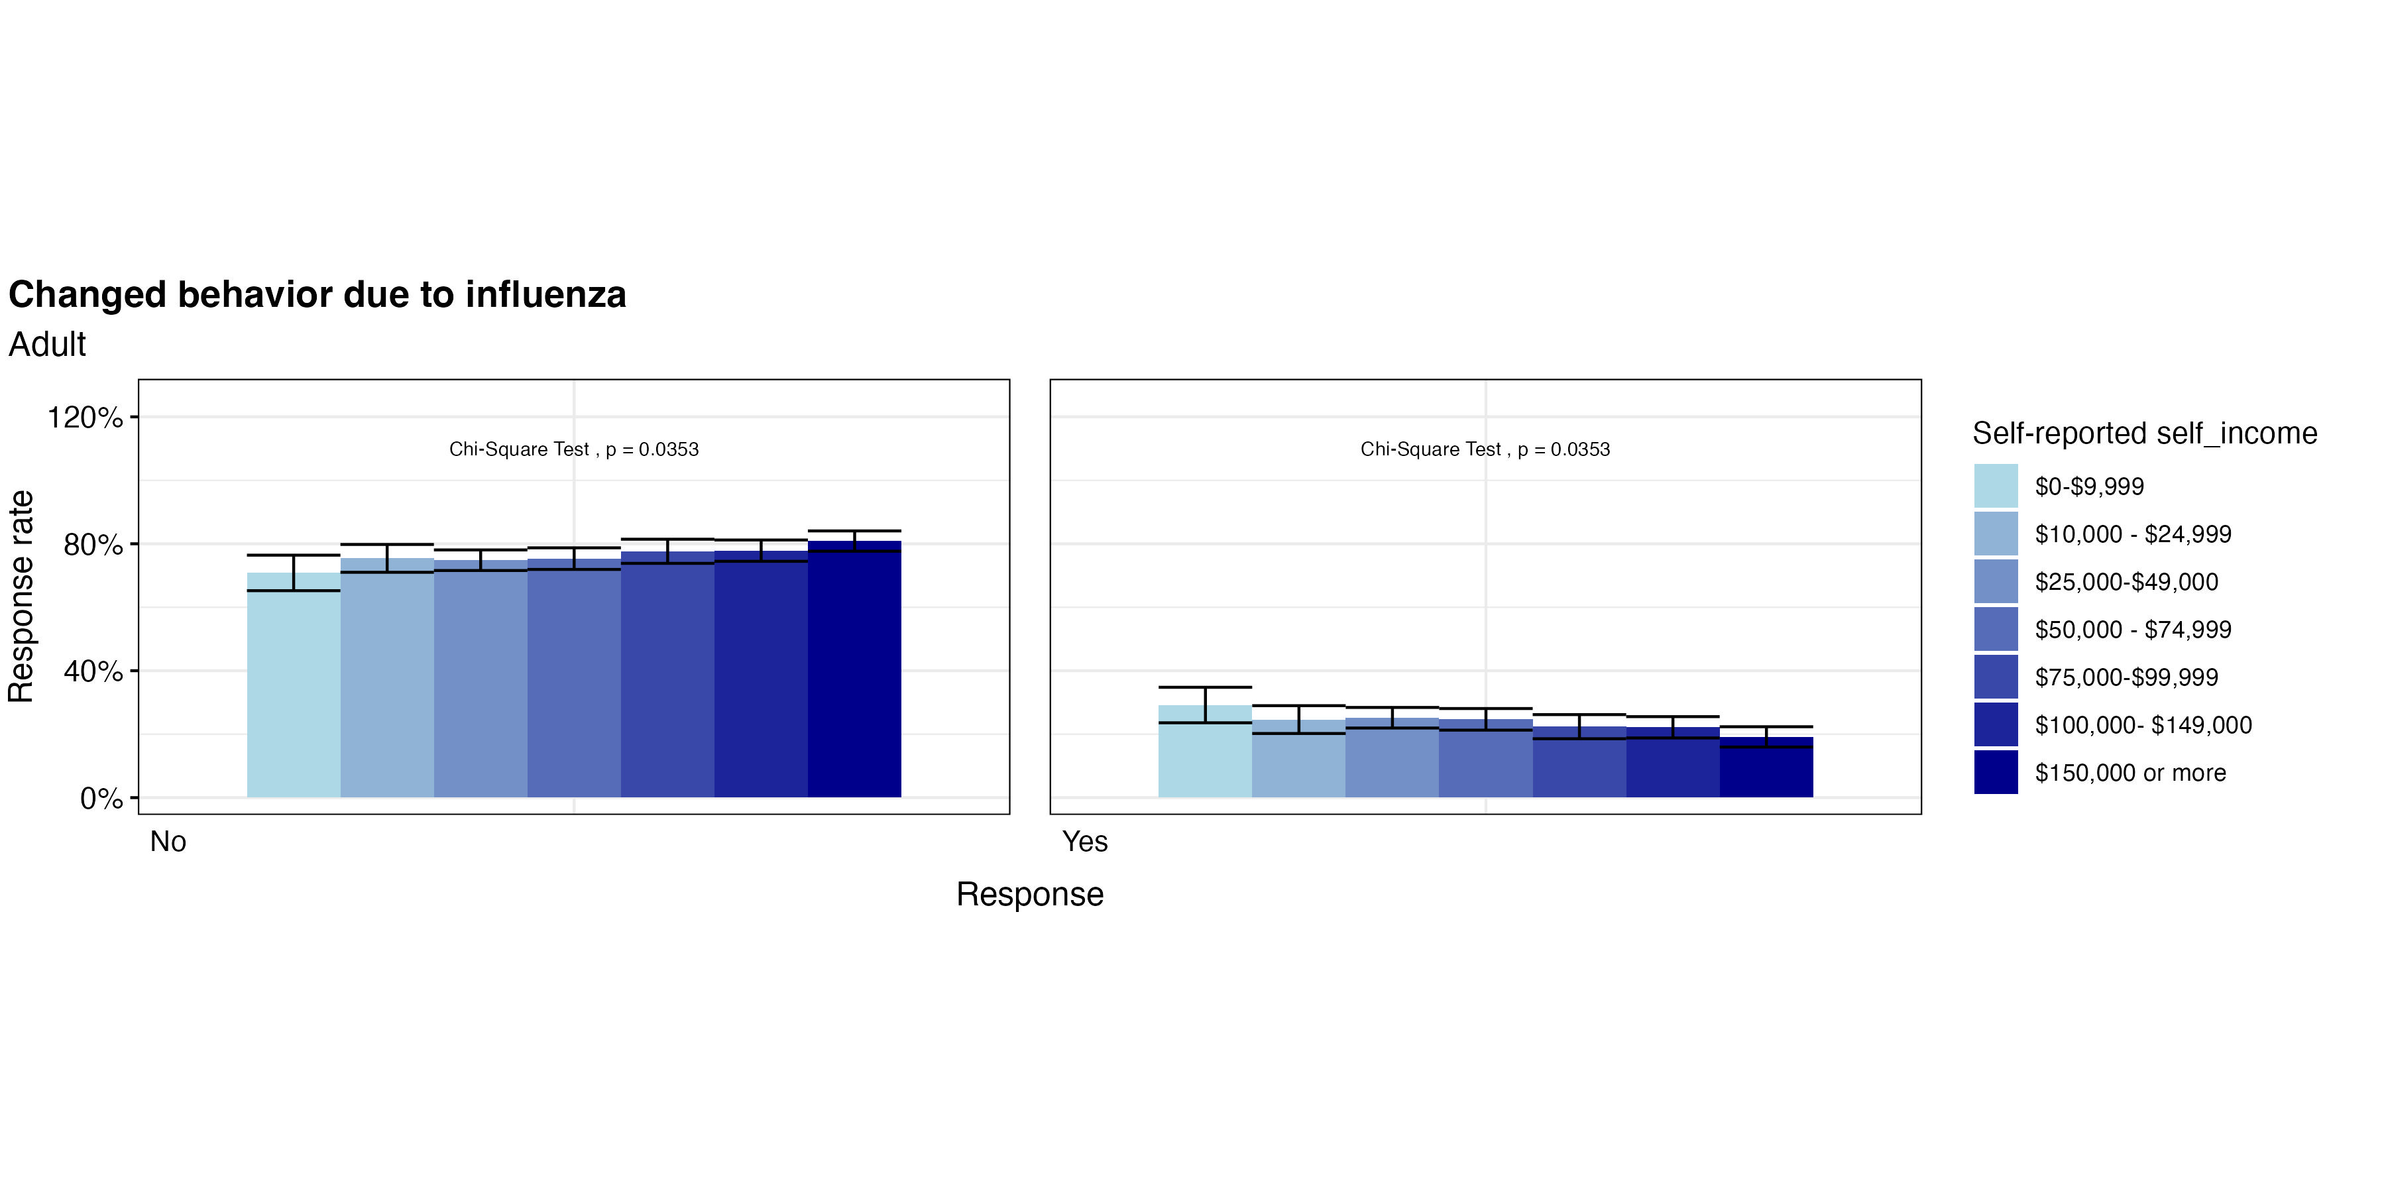
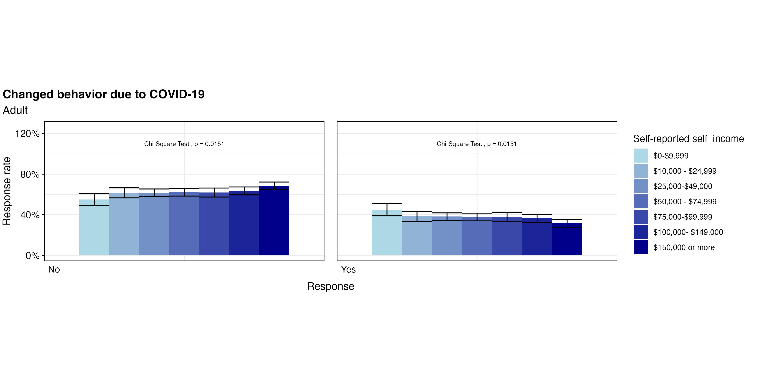

Changed Behavior Due to Disease

Slide 25
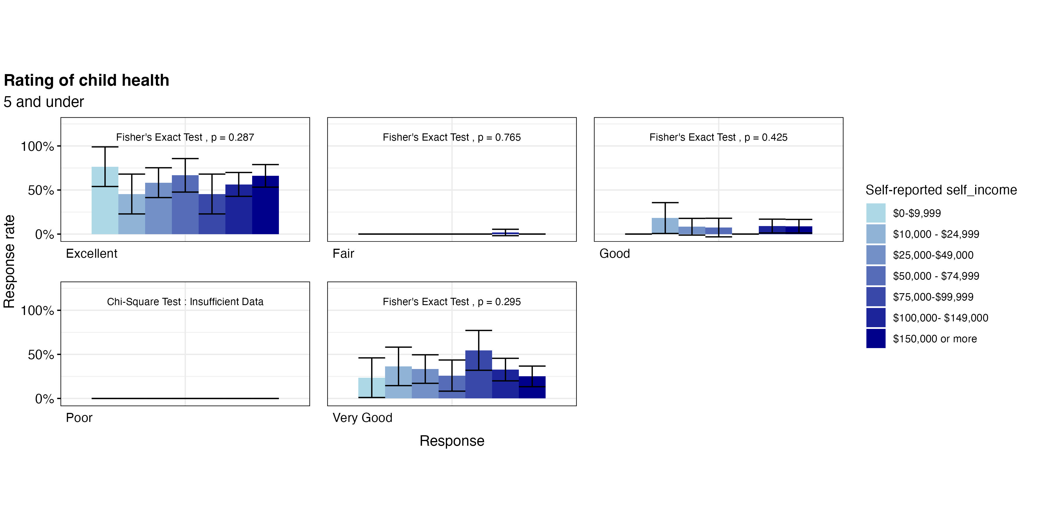
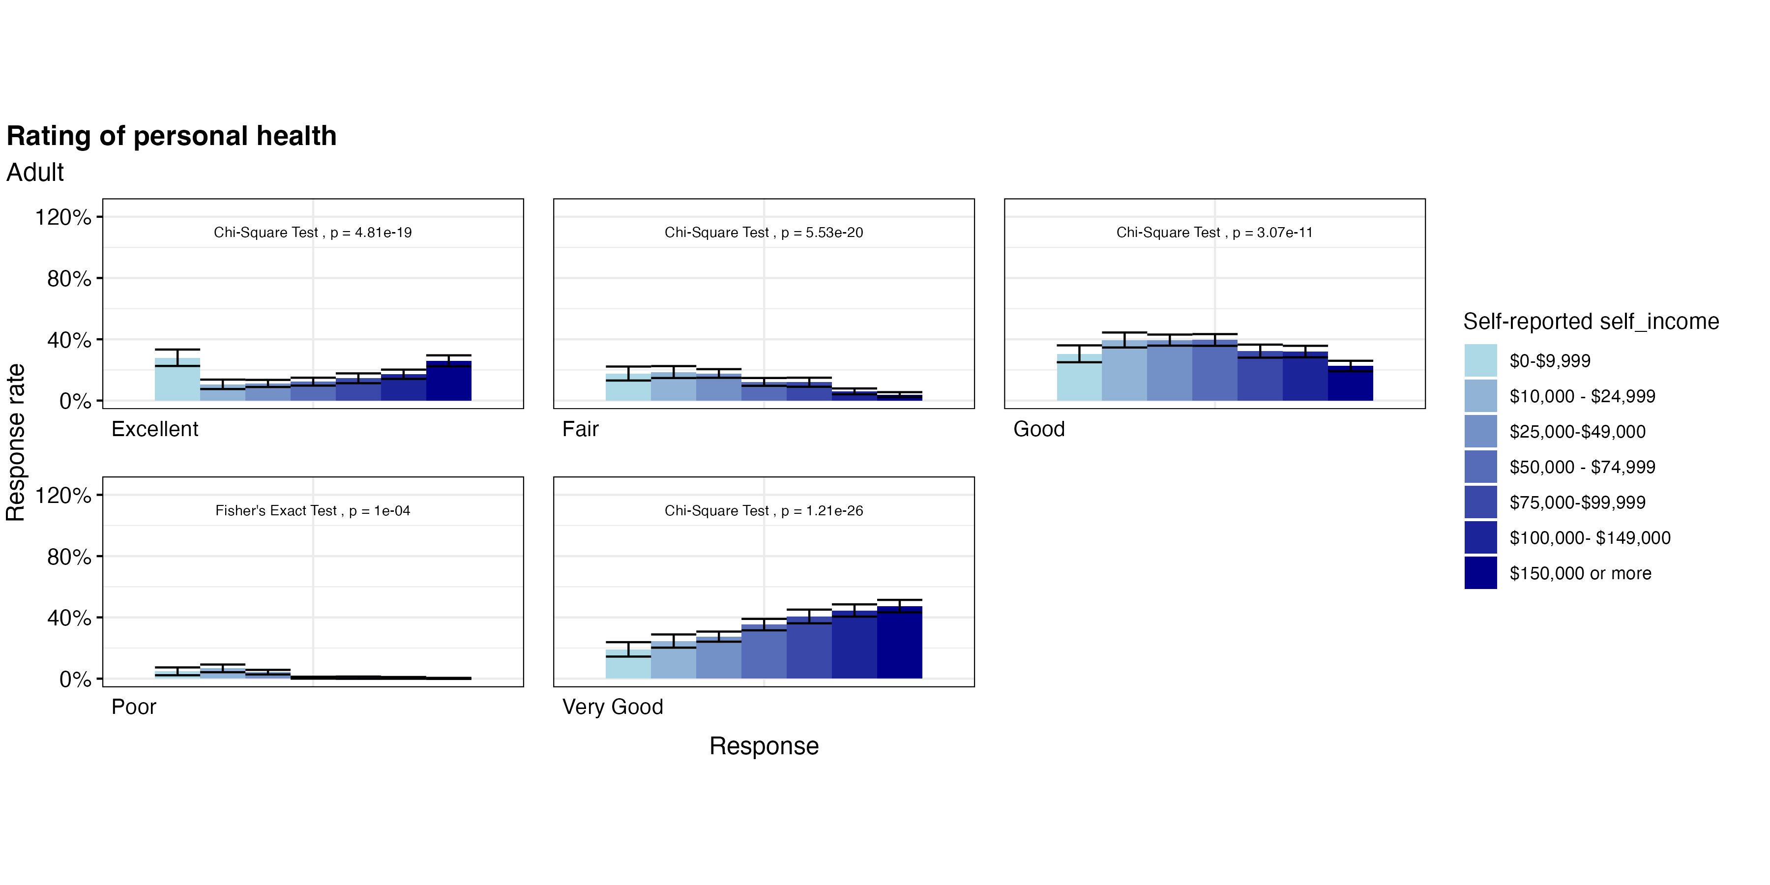
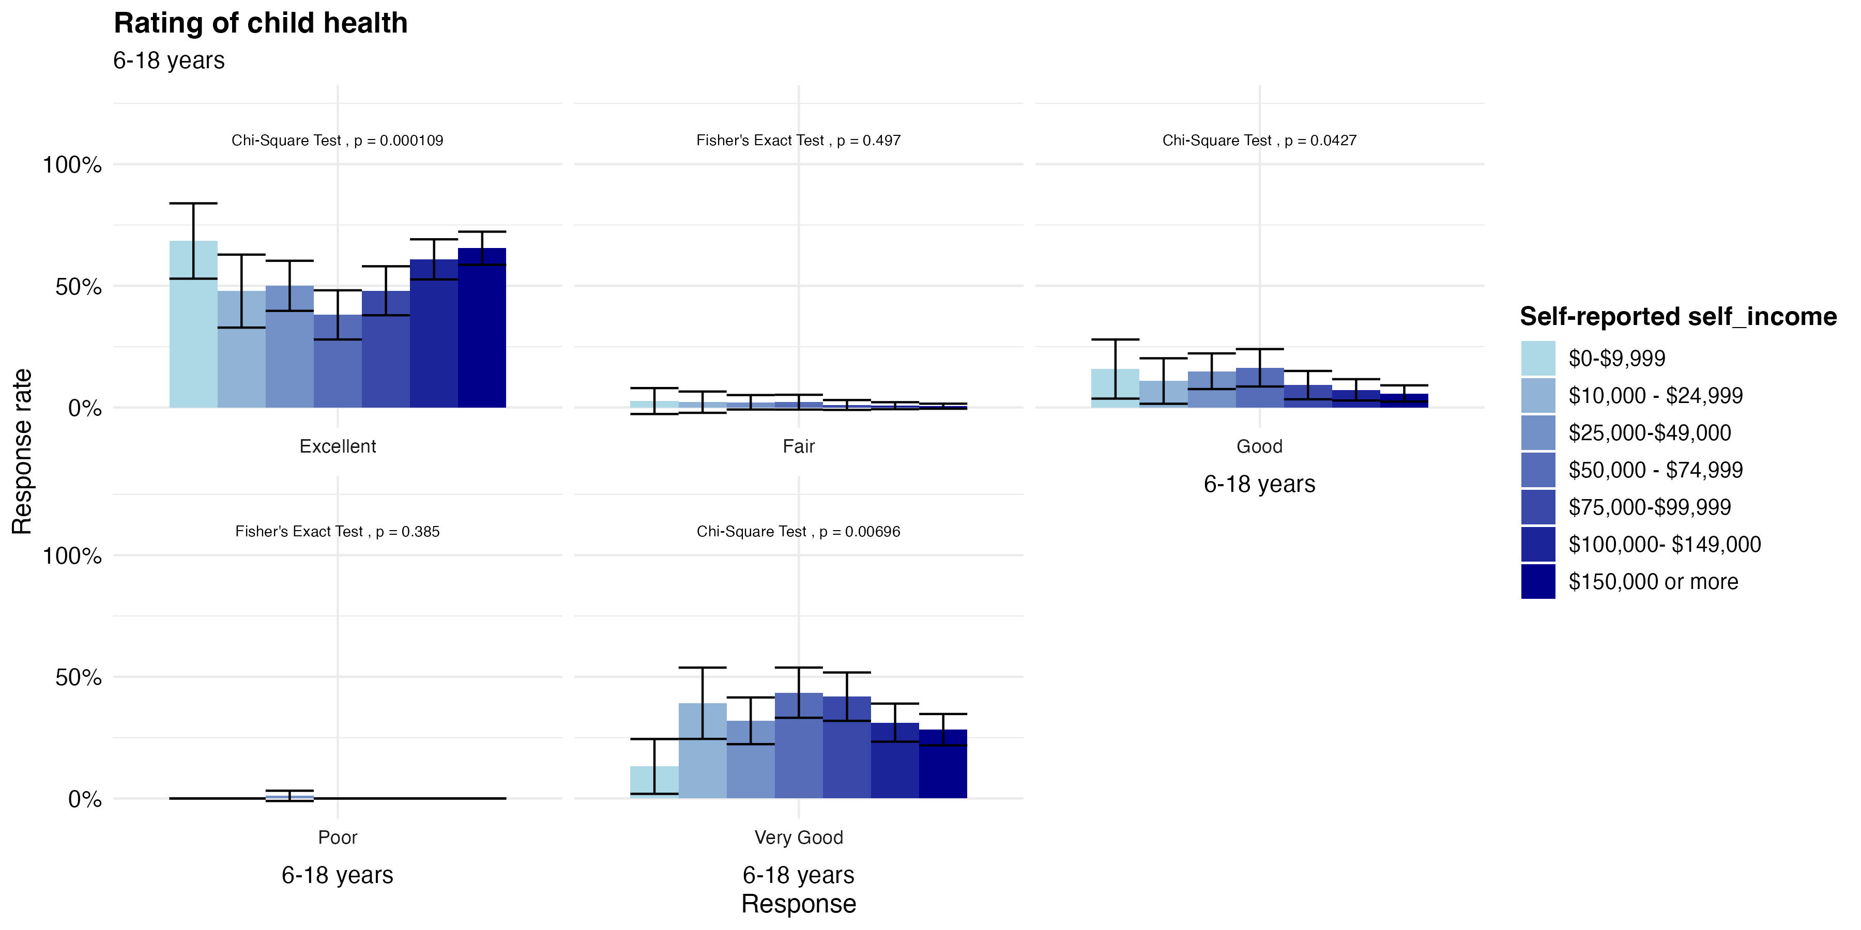
Recent Health

Slide 26
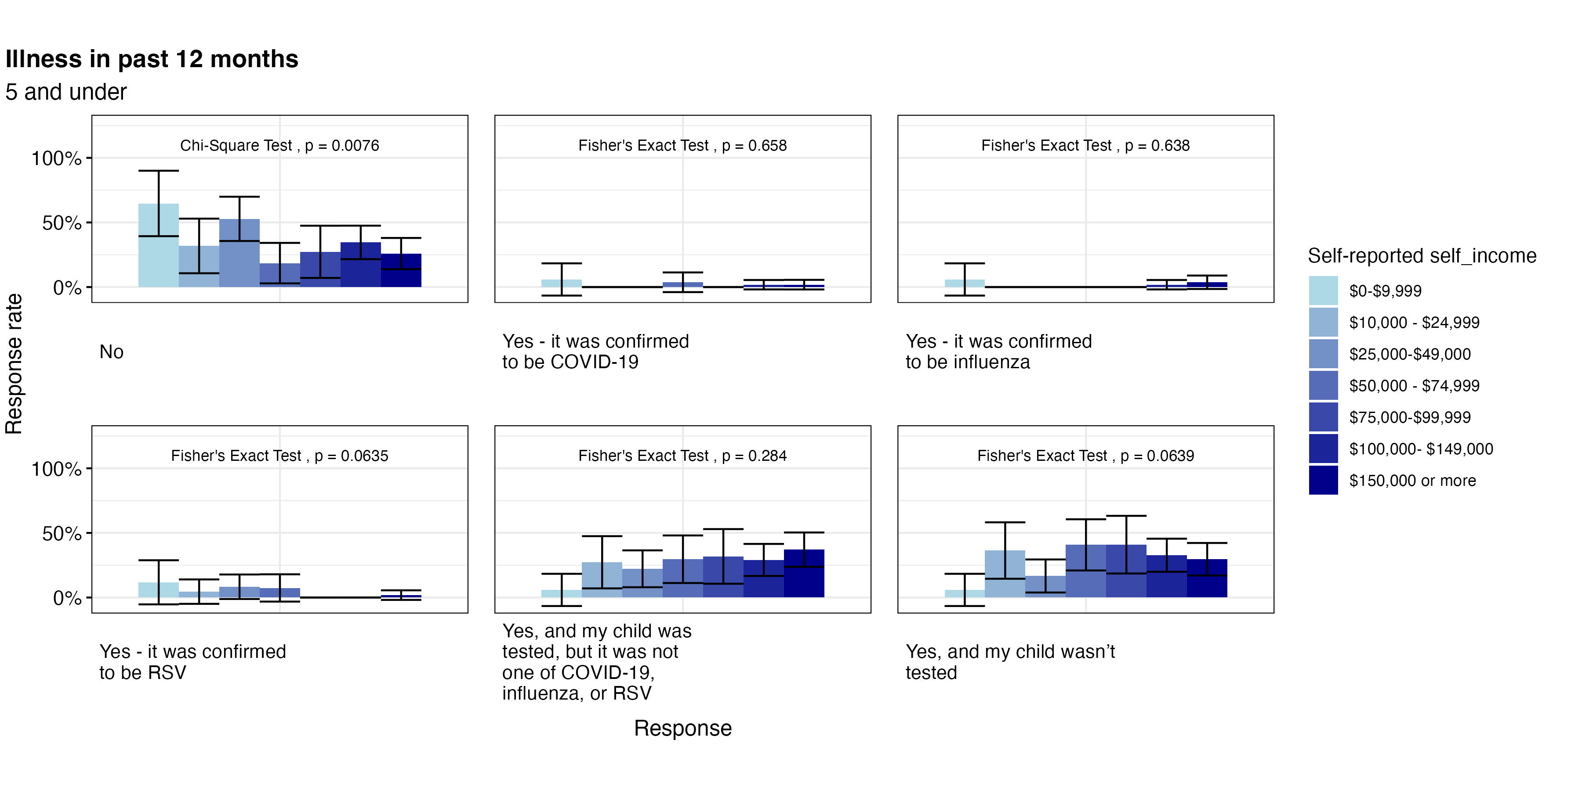


Illness in the past 12 Months

Slide 27



Days Out of the Month that Health Interferes with Activity

Slide 28

COVID-19 Testing

